Slide 1
Sea Surface Temperature pattern scaling
Build a separate pattern for each month
No forcing of month to month consistency – we decided this was acceptable for the scope and focus of Hector-COMBO EPA work
Patterns built from 5 realizations of RCP 4.5 from CanESM2.
Errors in pattern scaling in the HI, FL, PR regions of interest definitely could be within relevant sensitivity to coral health, but we figured that is mostly an issue for result interpretation when comparing pattern scale results to ESM results. Comparing a patterned scale results at 1.5 degC to a patterned scale result at 2 degC should be more consistent.

Slide 2
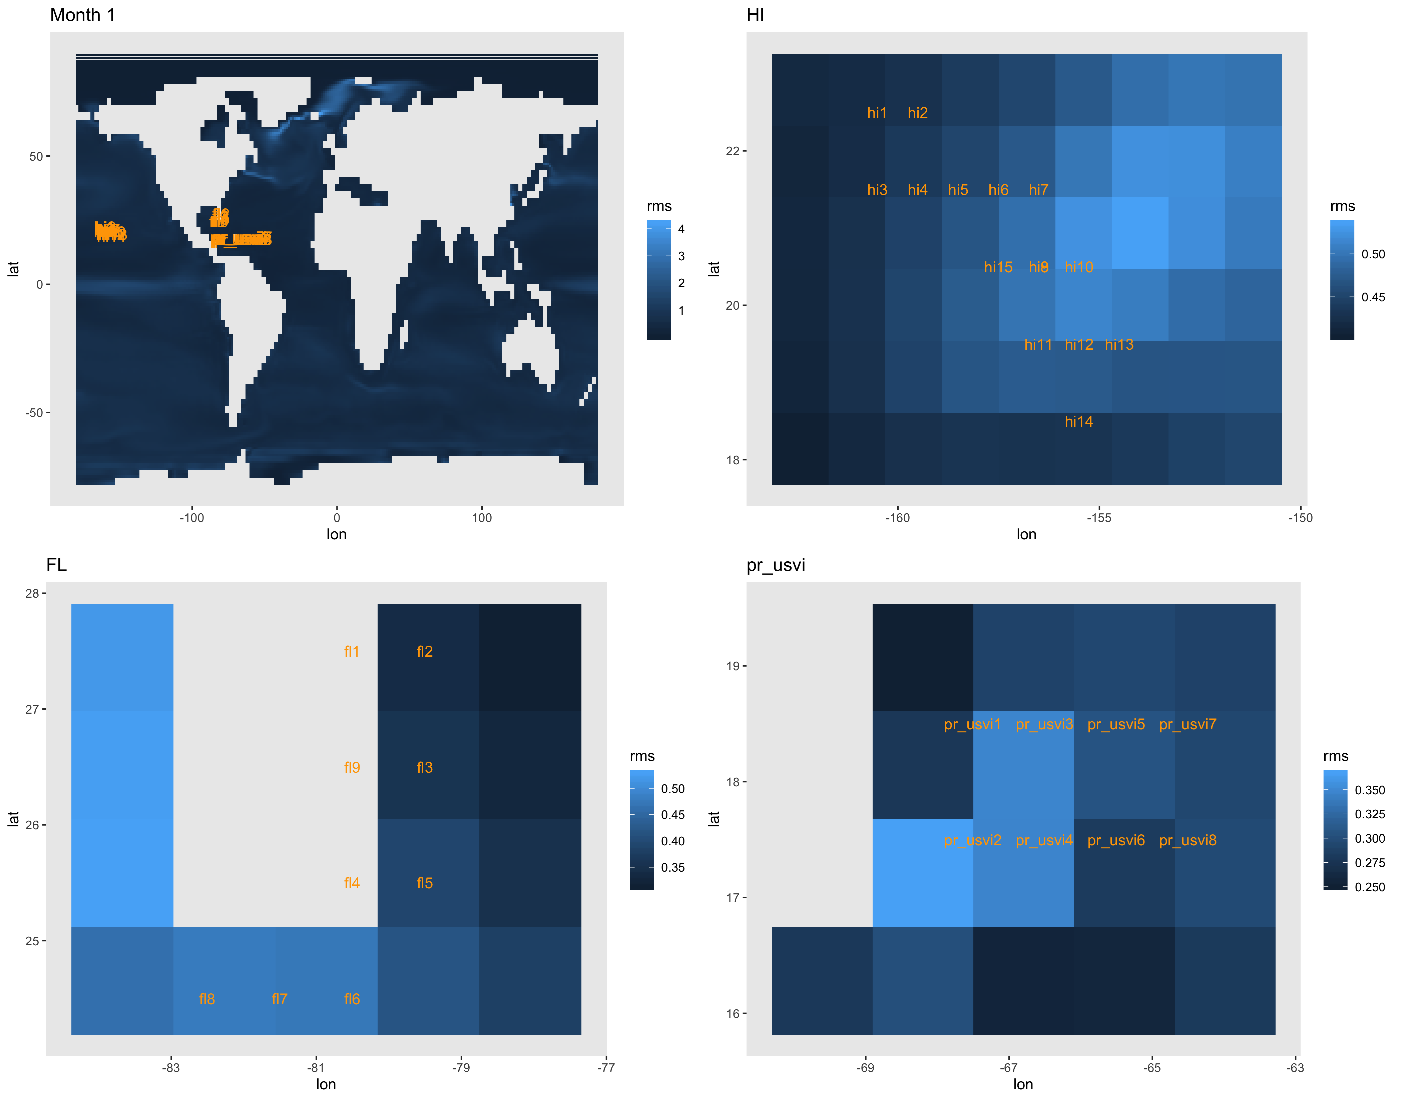
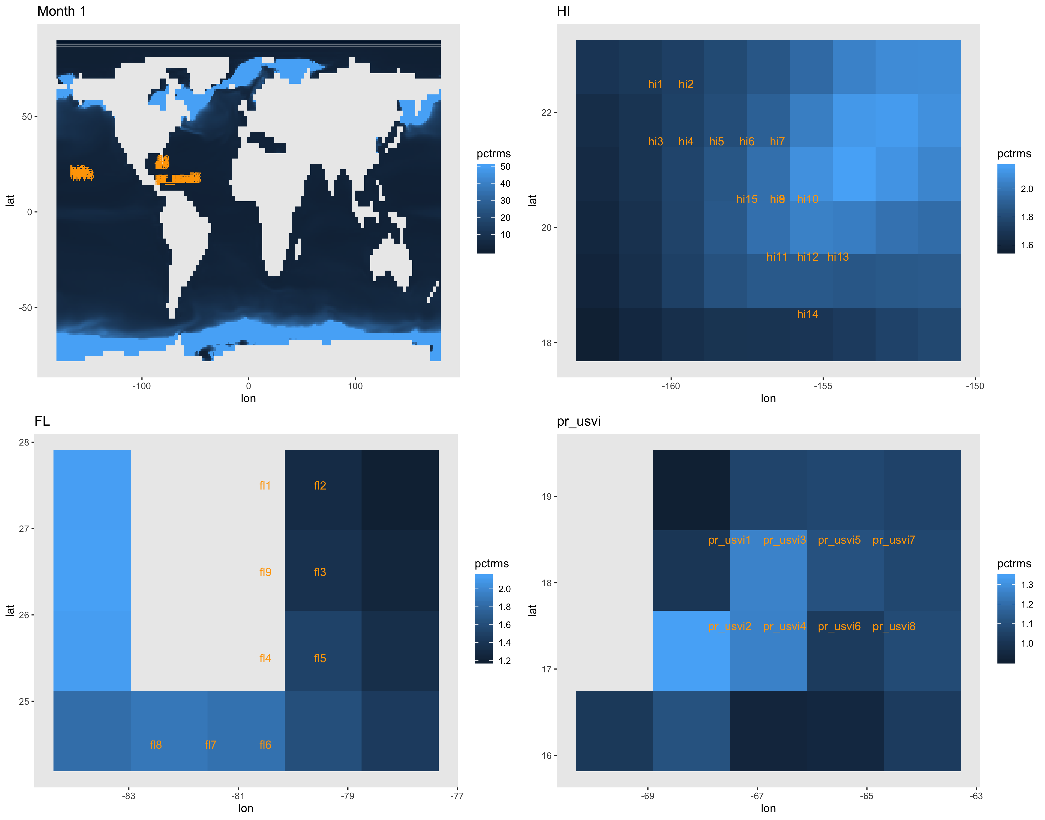
Global maps to check overall possibility of pattern scaling SST. Other 3 panels in each figure are the errors at the sites of interest for the EPA coral health work. Every panel is on its own color bar scale because they are prelim figures, sorry!
RMS as percent of local ESM temperature.
Color bar capped at 50% error on the global map.
RMS in degrees celsius

Slide 3
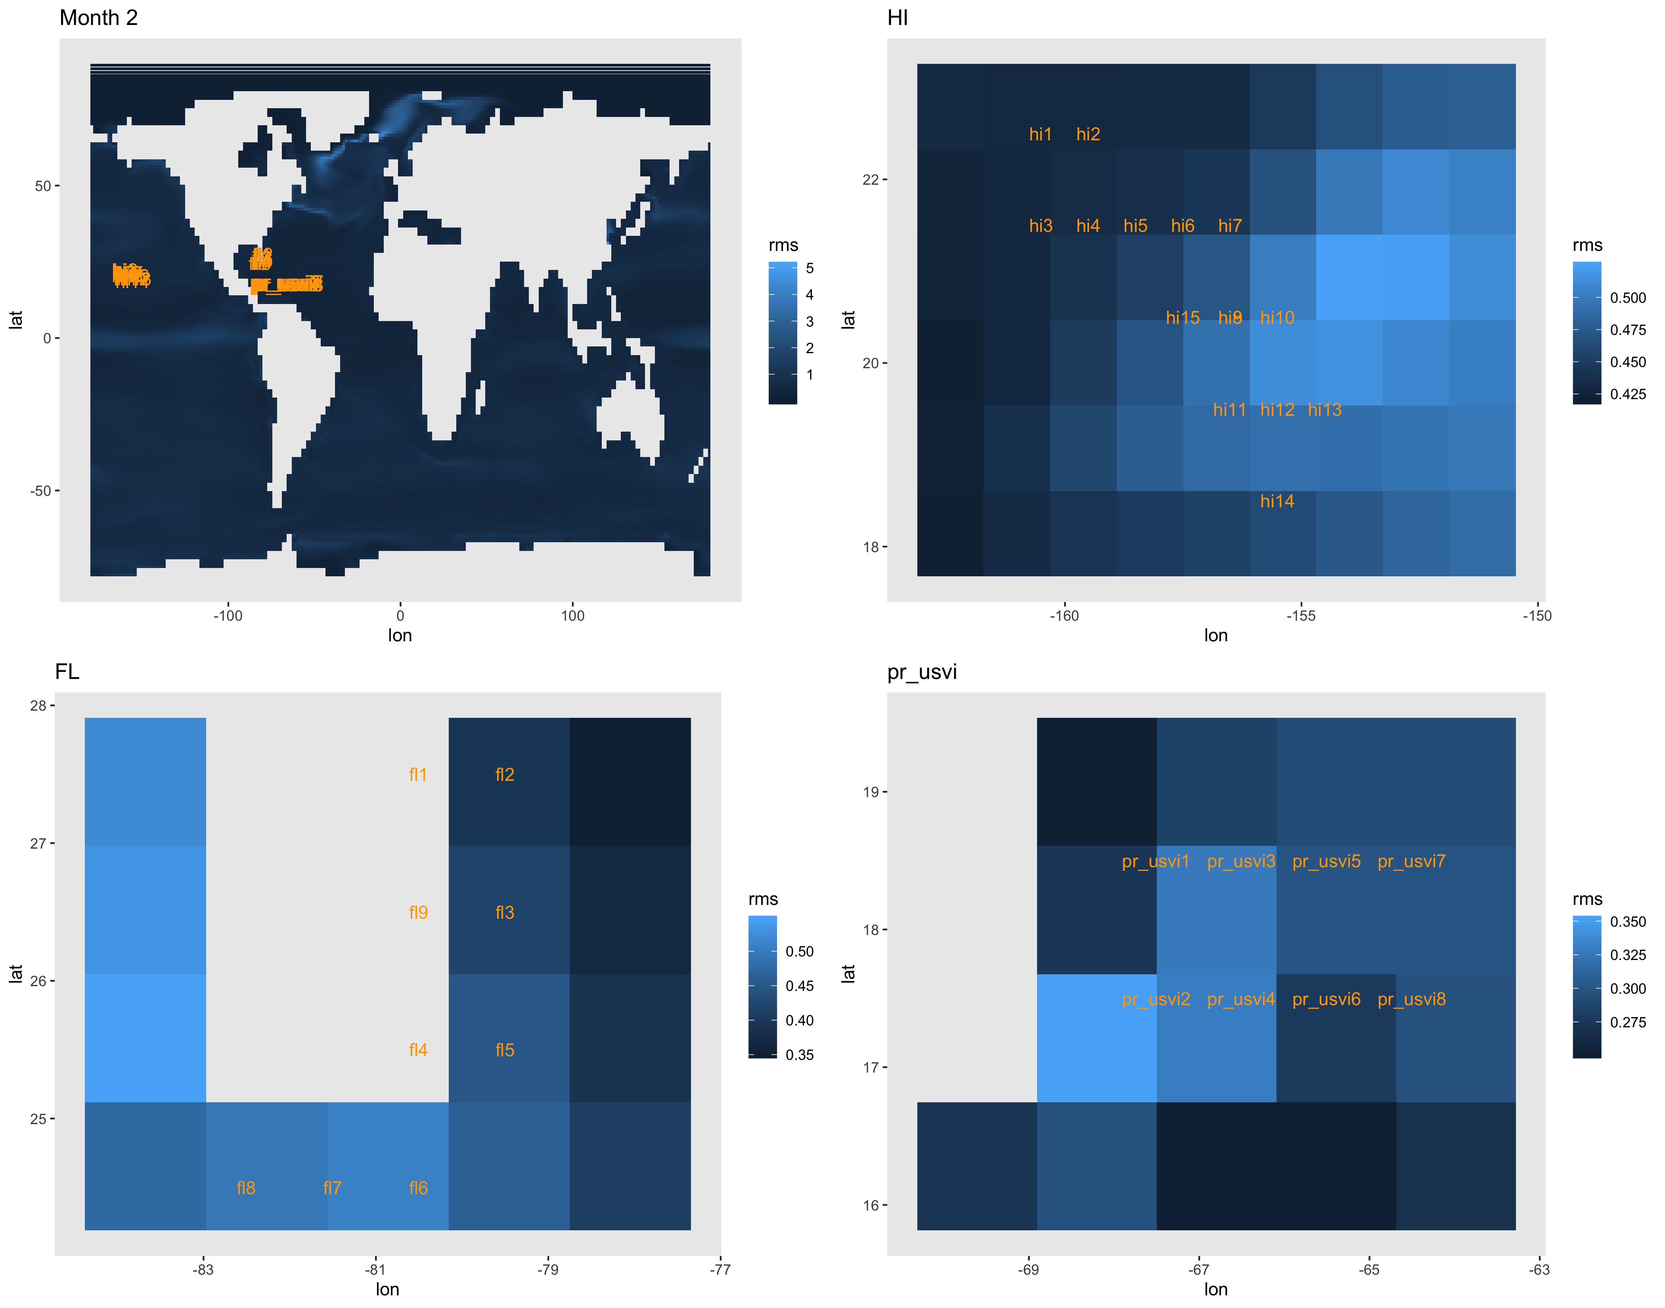
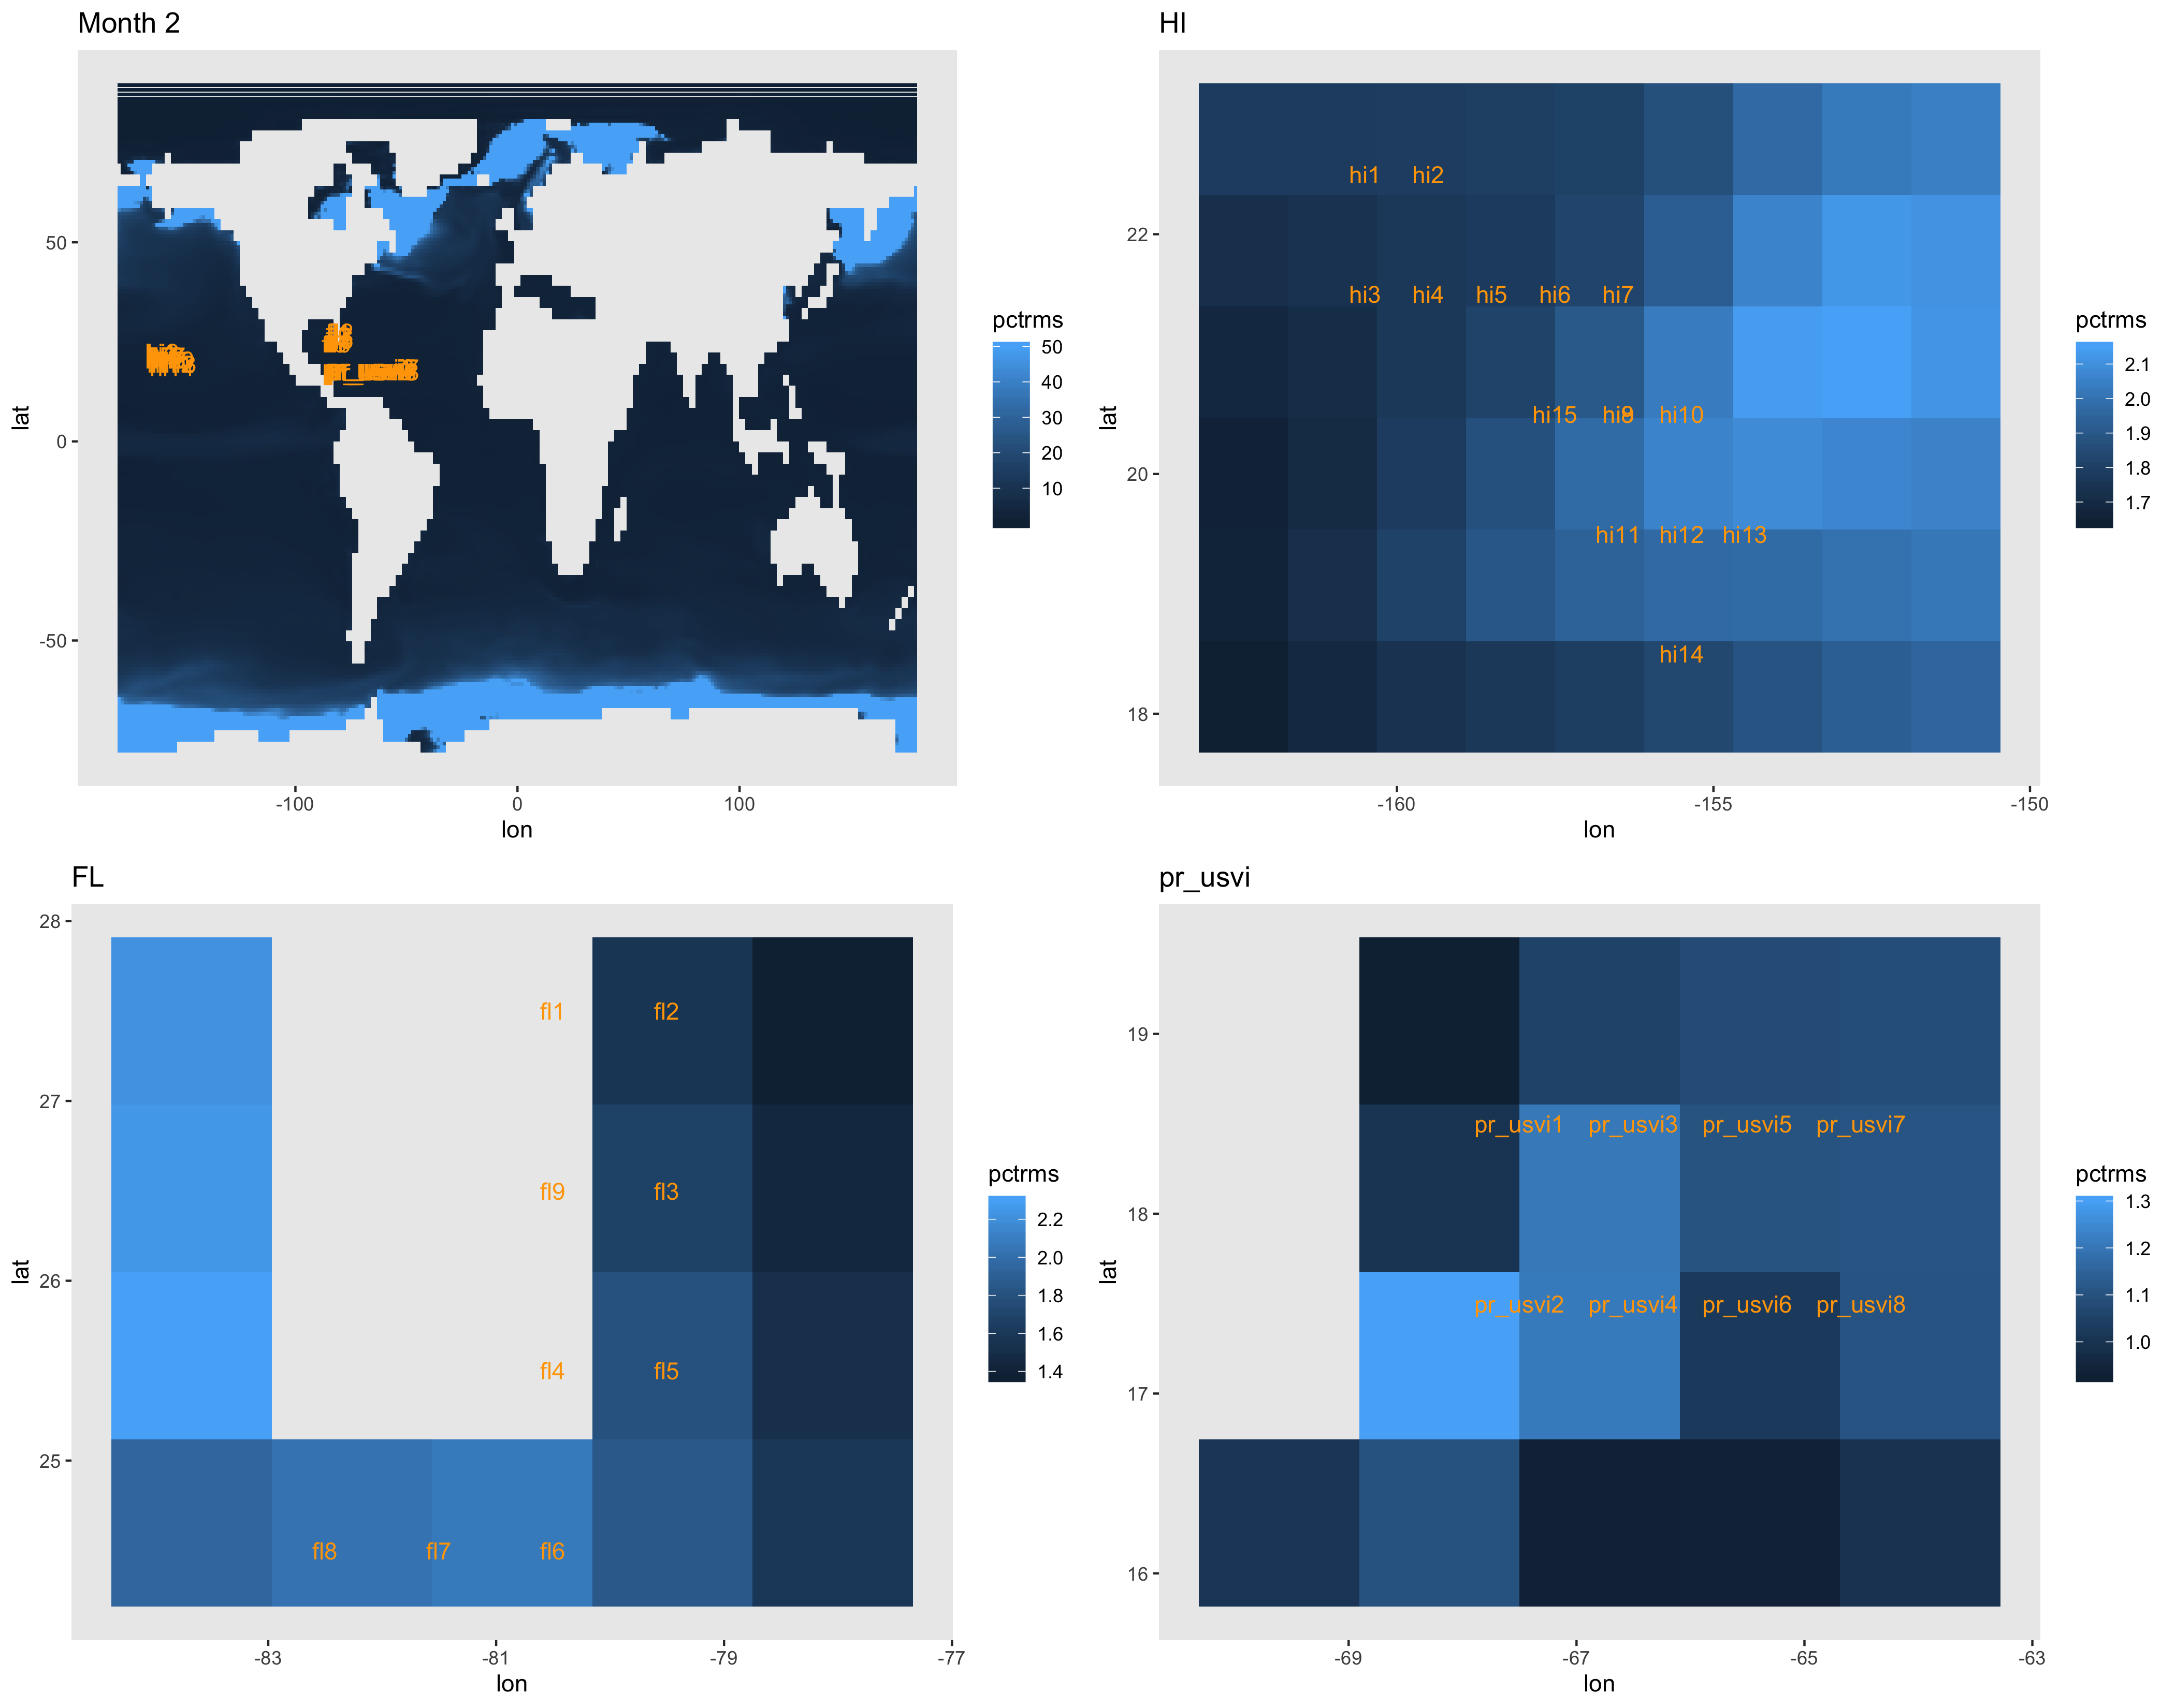
RMS as percent of local ESM temperature.
Color bar capped at 50% error on the global map.
RMS in degrees celsius

Slide 4
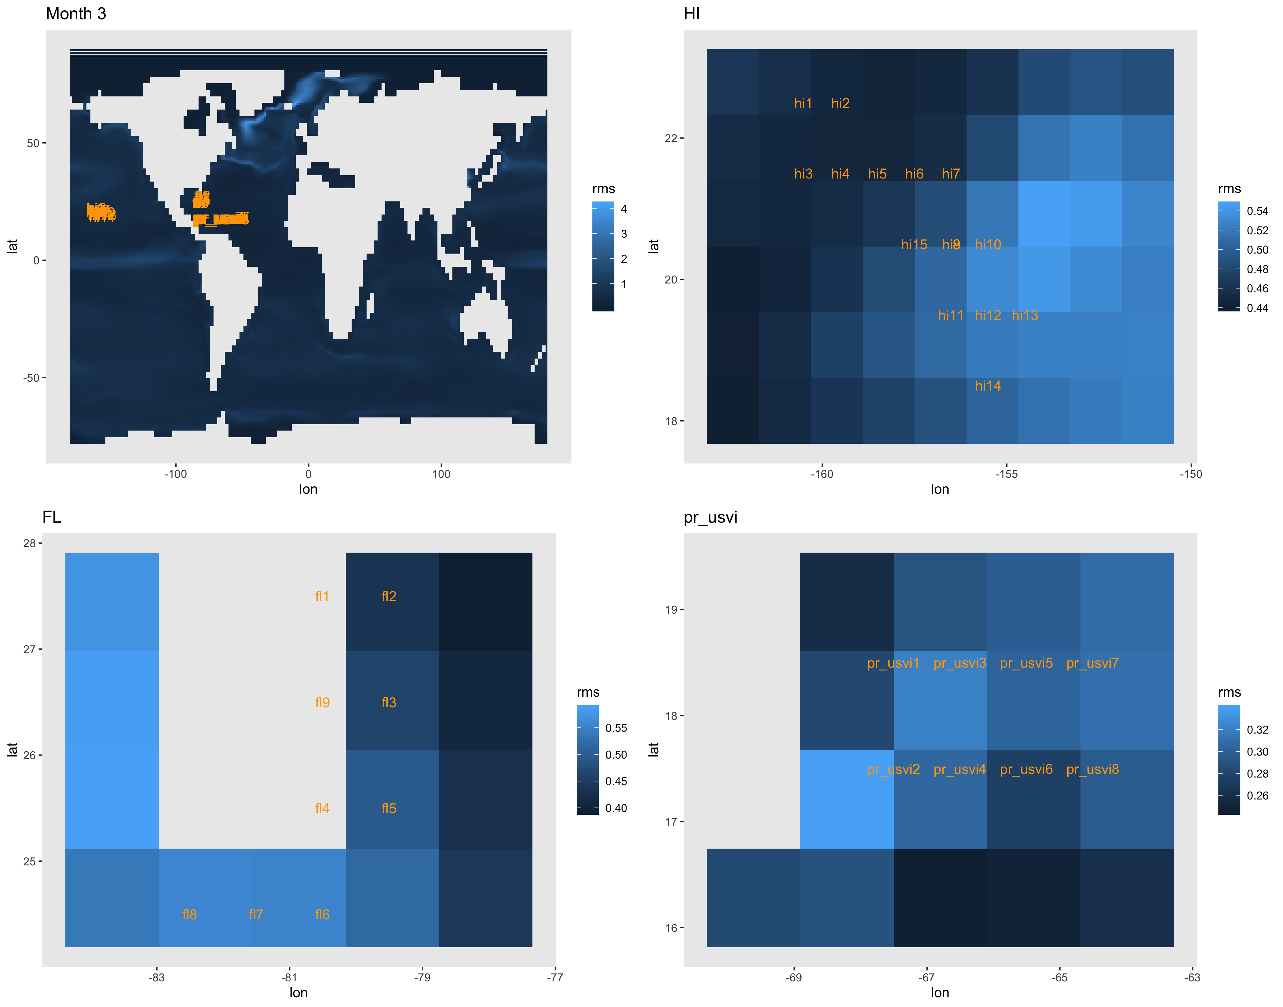
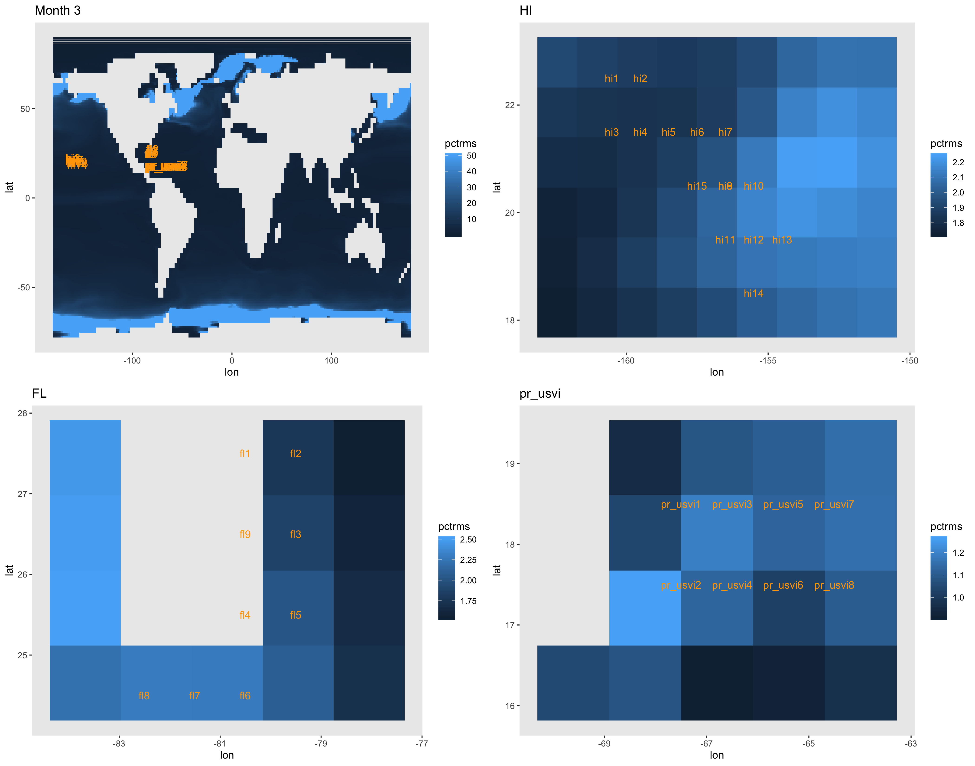
RMS as percent of local ESM temperature.
Color bar capped at 50% error on the global map.
RMS in degrees celsius

Slide 5
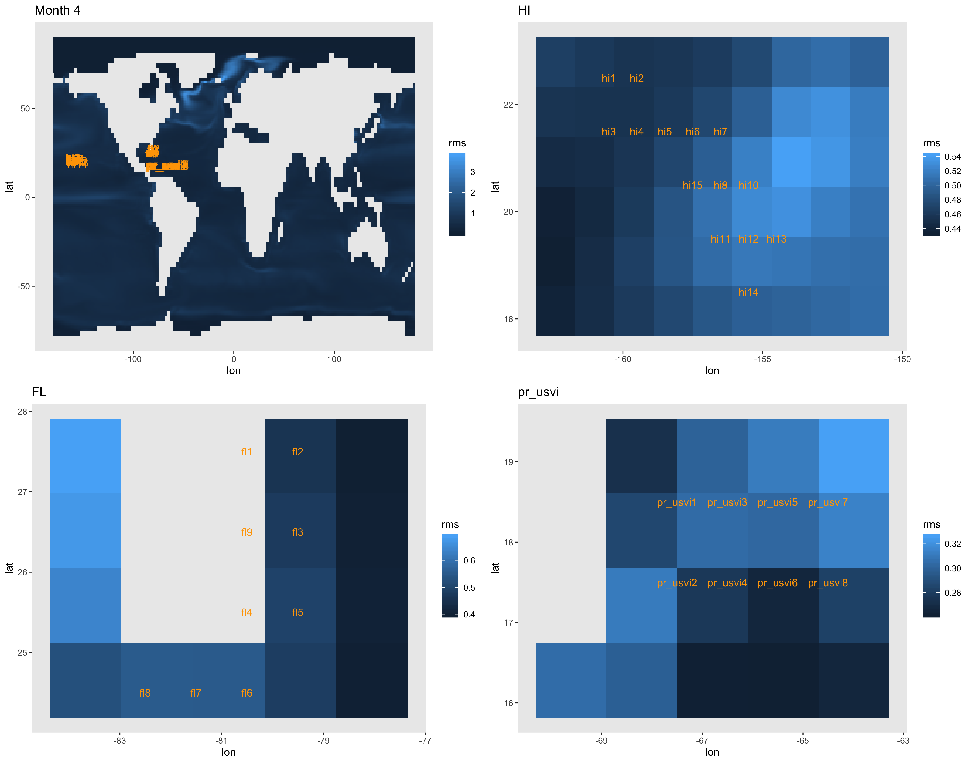
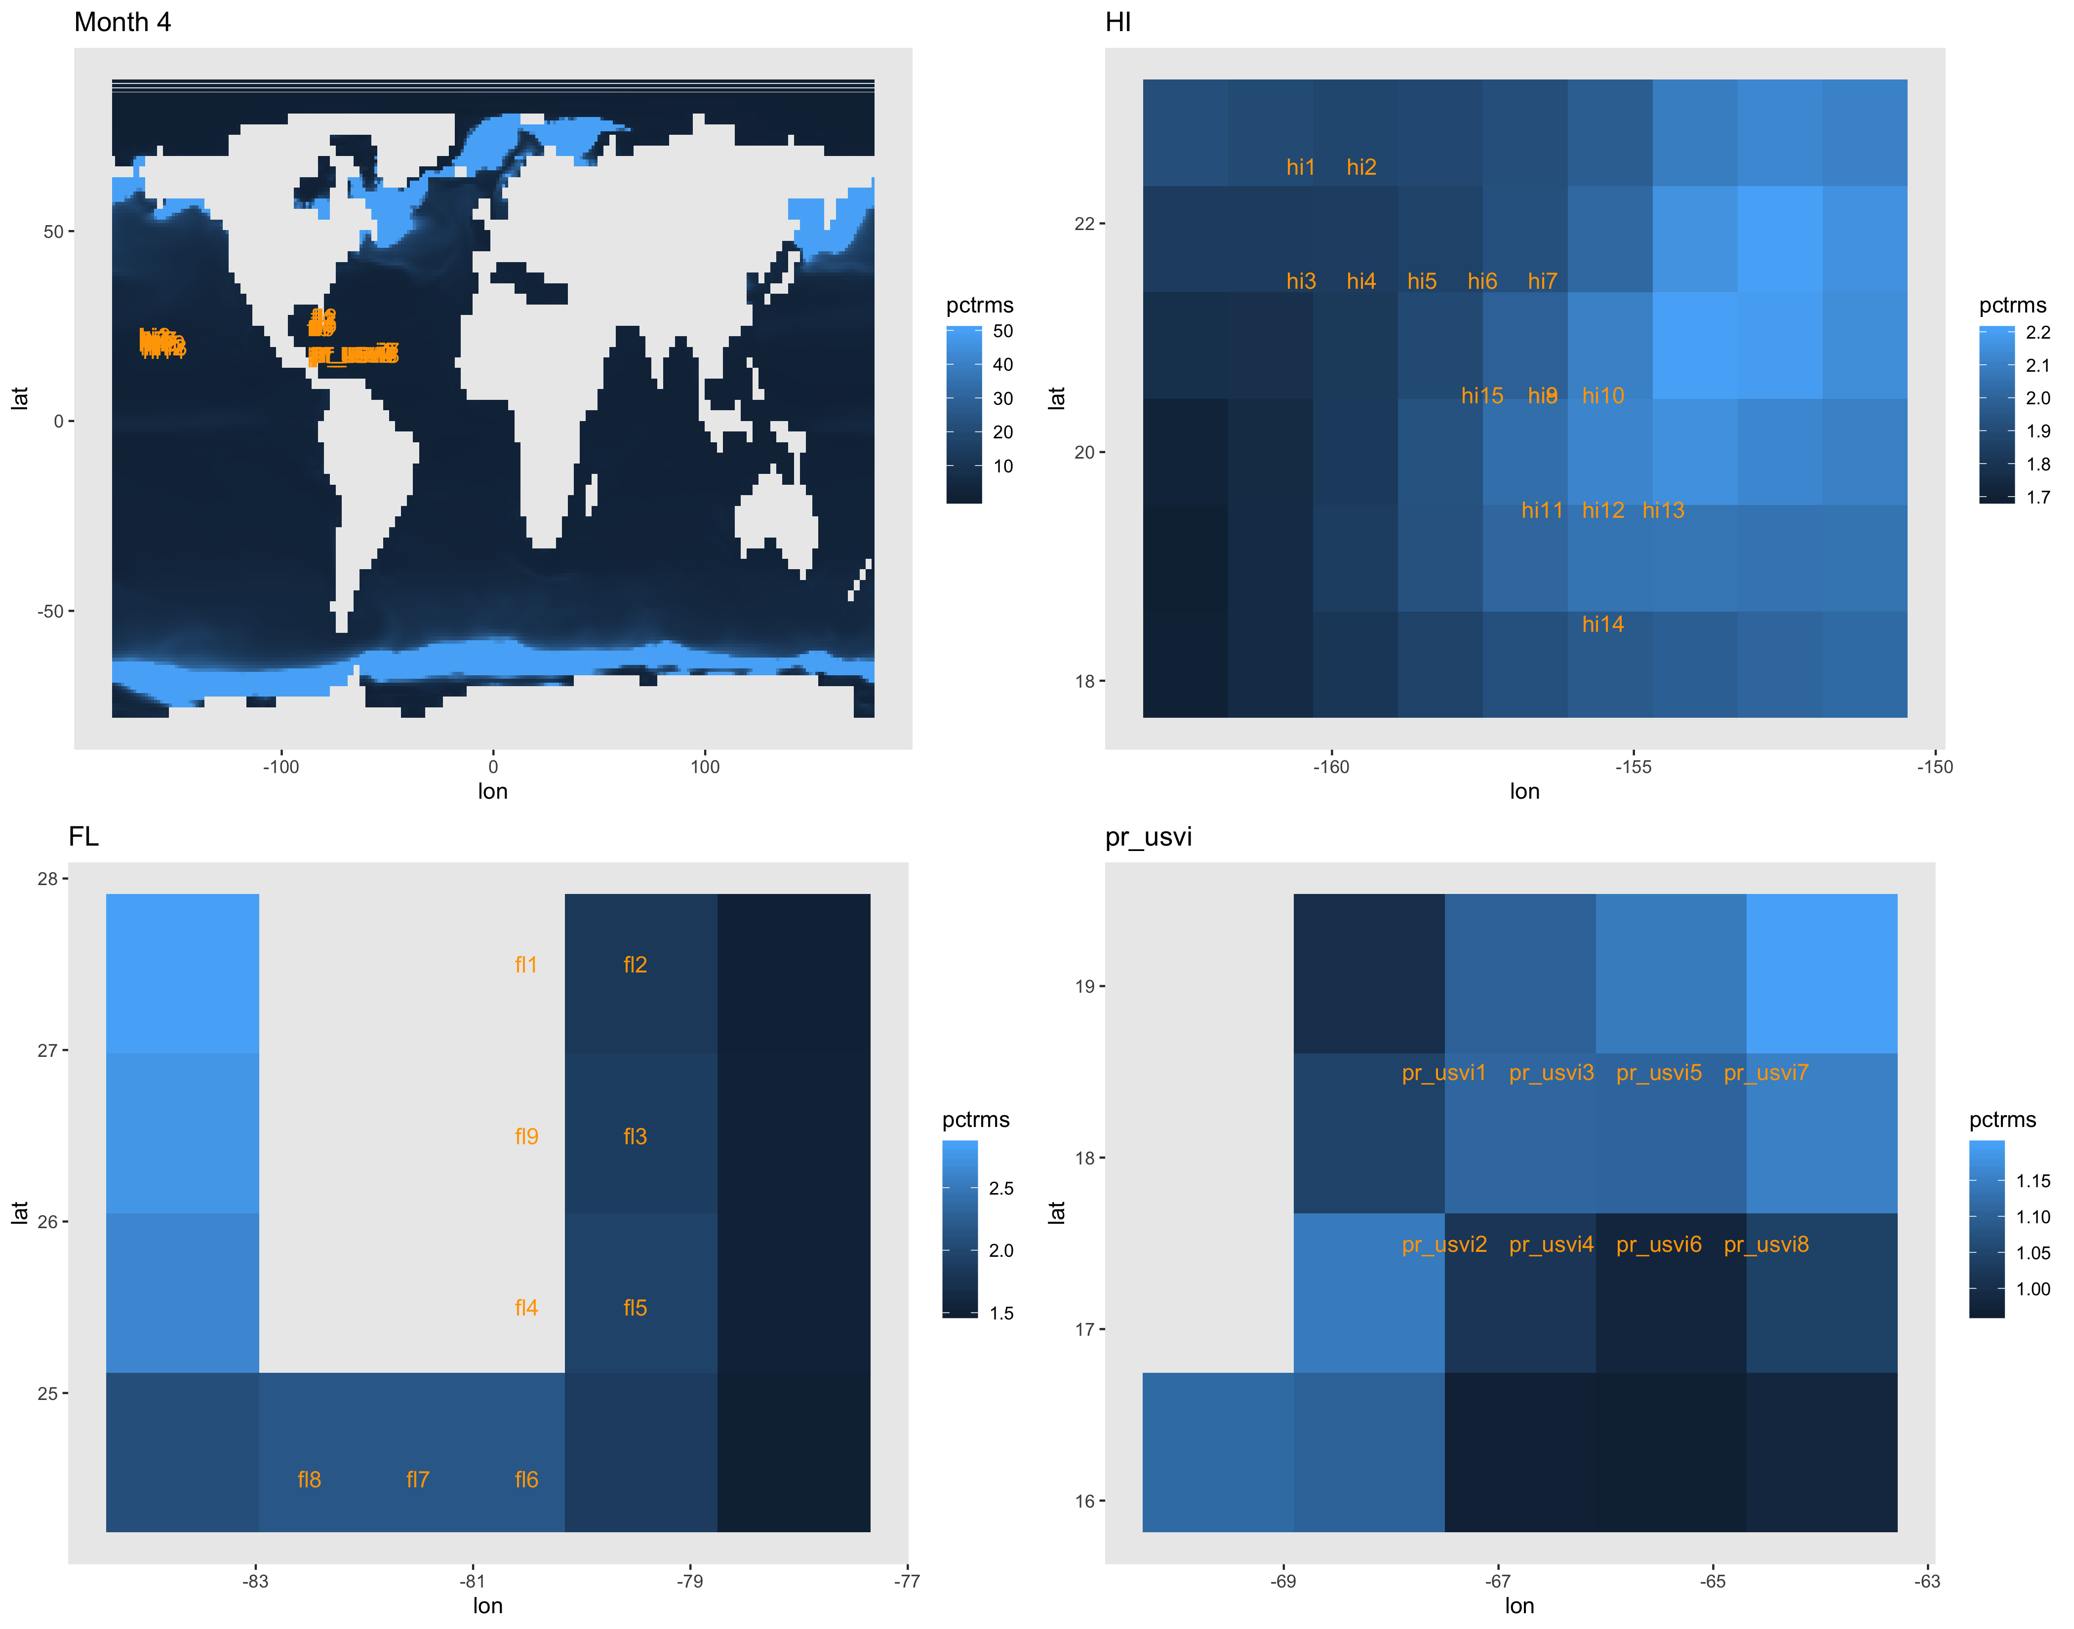
RMS as percent of local ESM temperature.
Color bar capped at 50% error on the global map.
RMS in degrees celsius

Slide 6
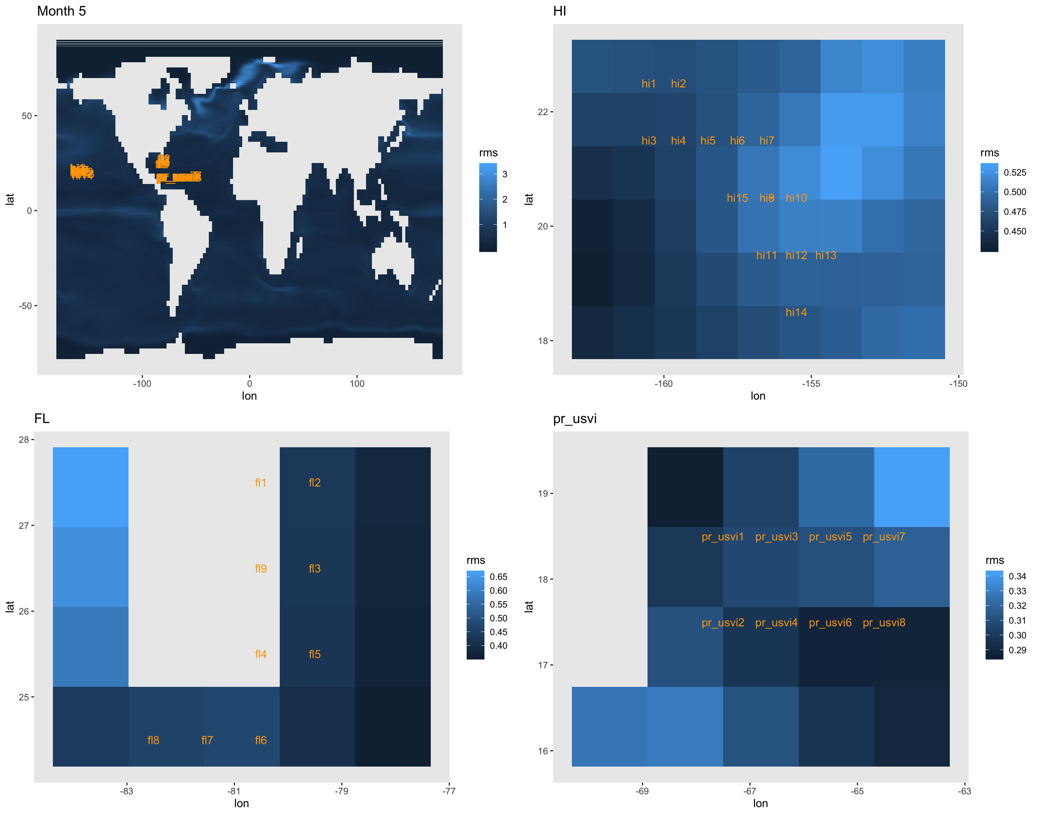
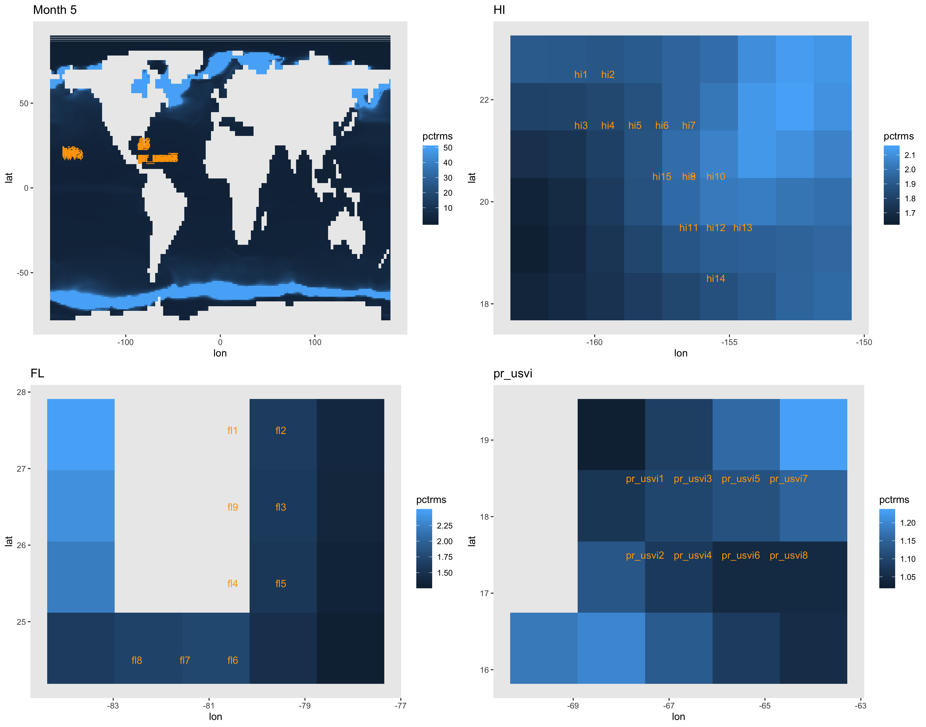
RMS as percent of local ESM temperature.
Color bar capped at 50% error on the global map.
RMS in degrees celsius

Slide 7
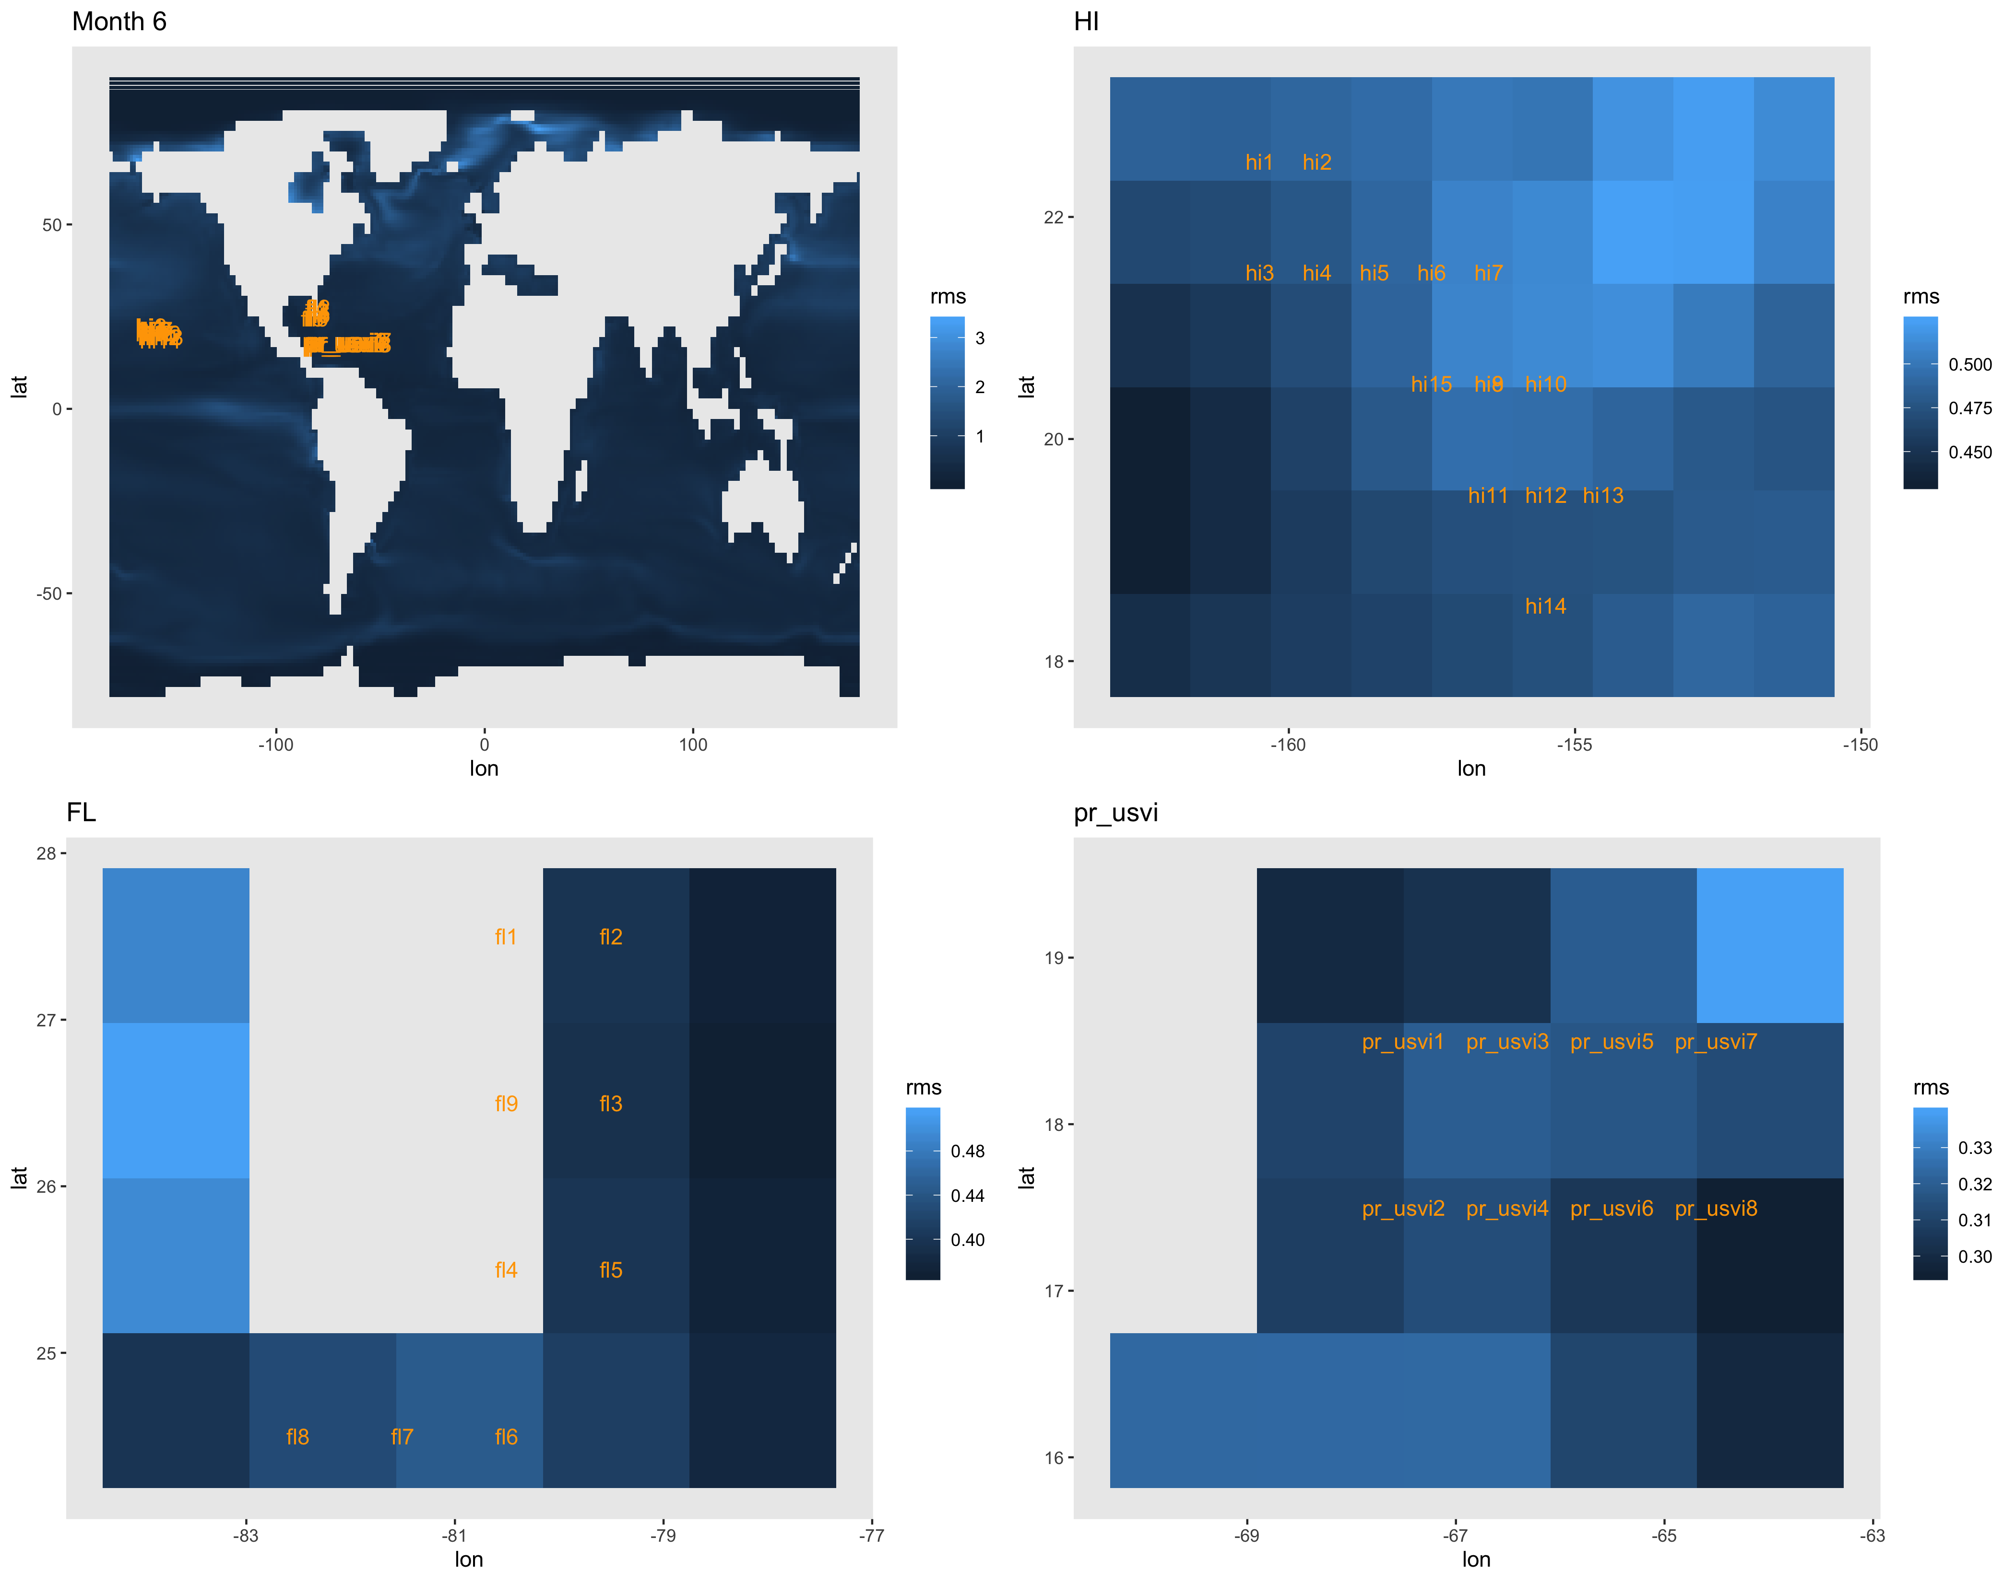
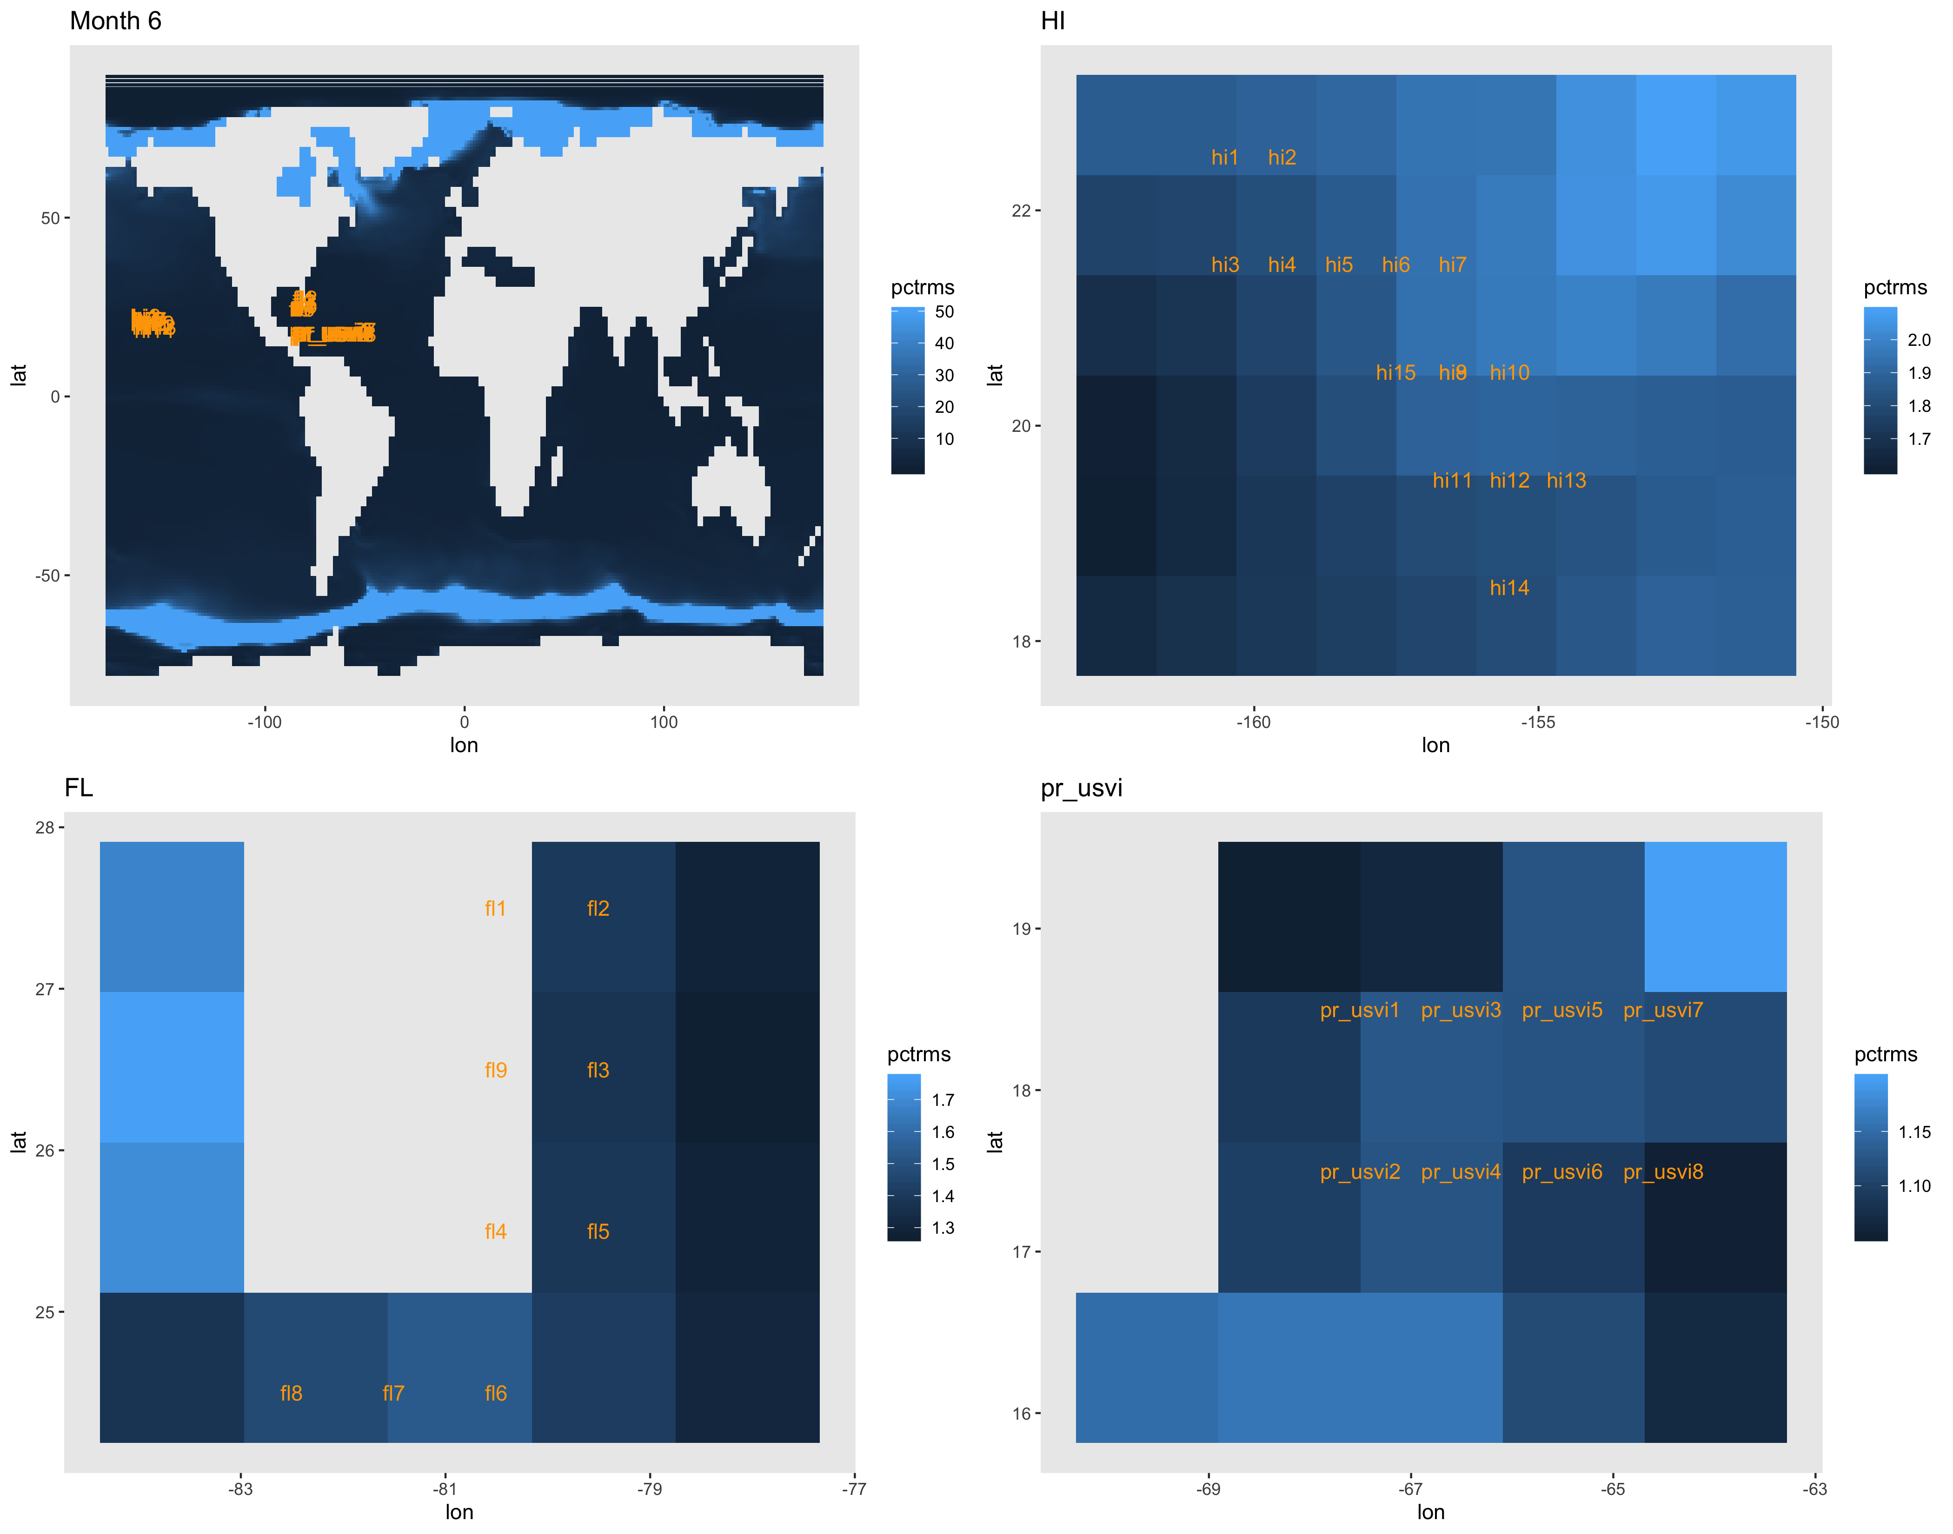
RMS as percent of local ESM temperature.
Color bar capped at 50% error on the global map.
RMS in degrees celsius

Slide 8
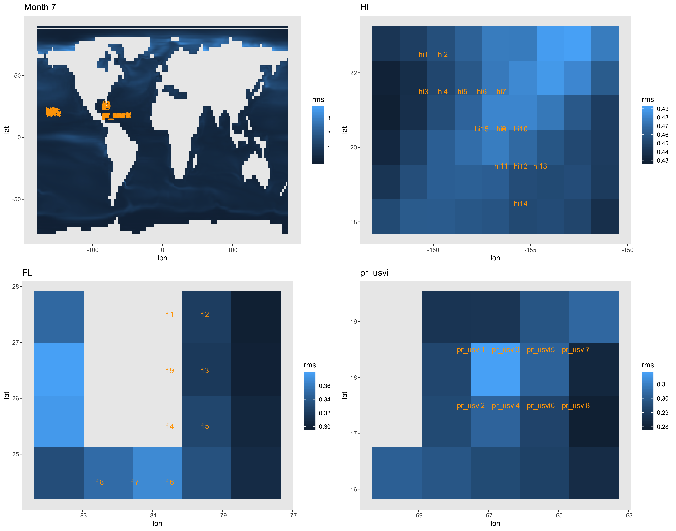
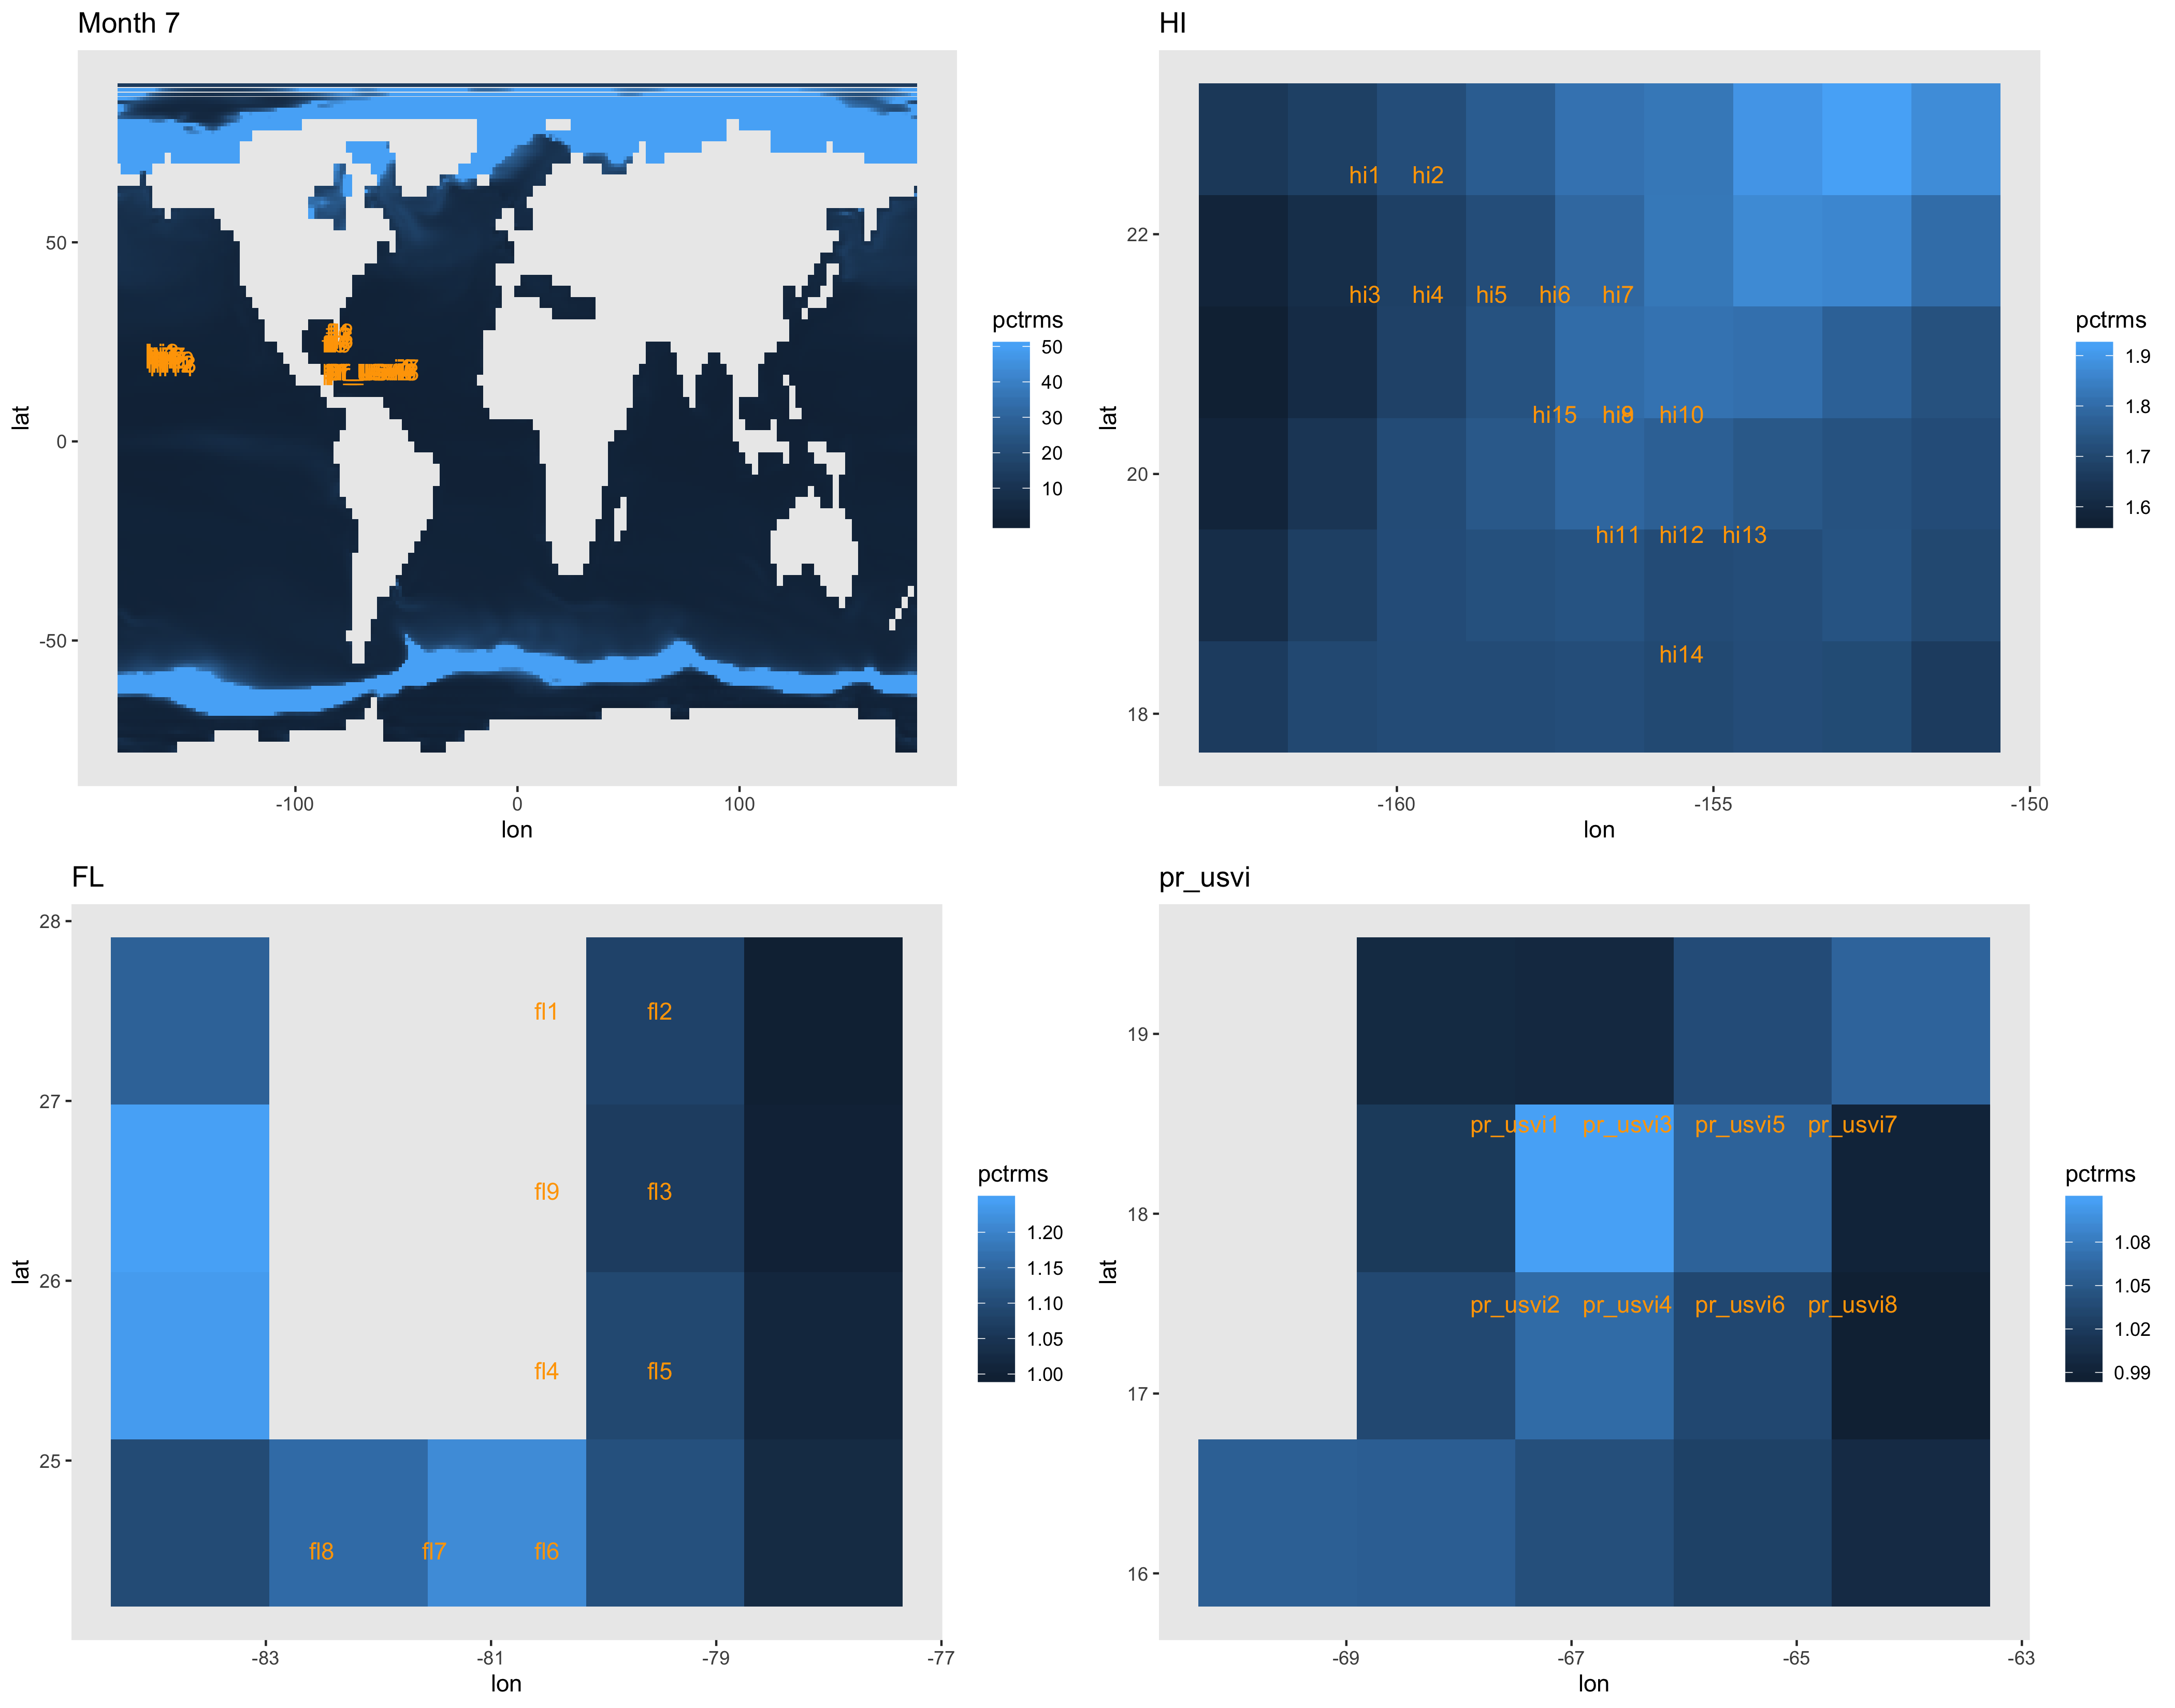
RMS as percent of local ESM temperature.
Color bar capped at 50% error on the global map.
RMS in degrees celsius

Slide 9
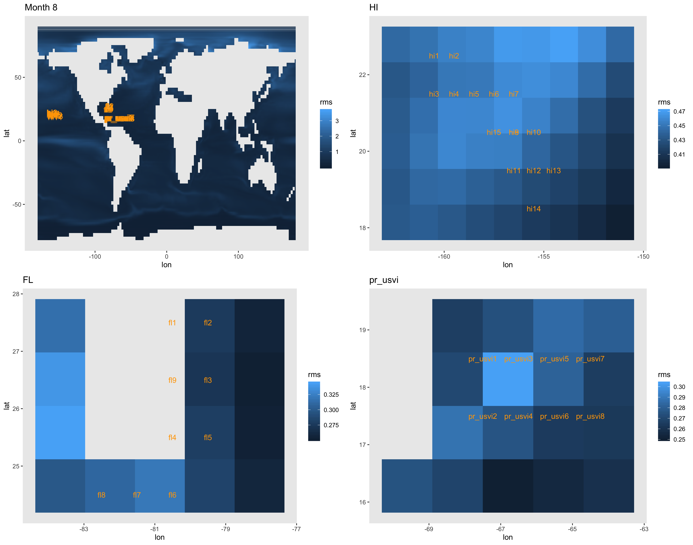
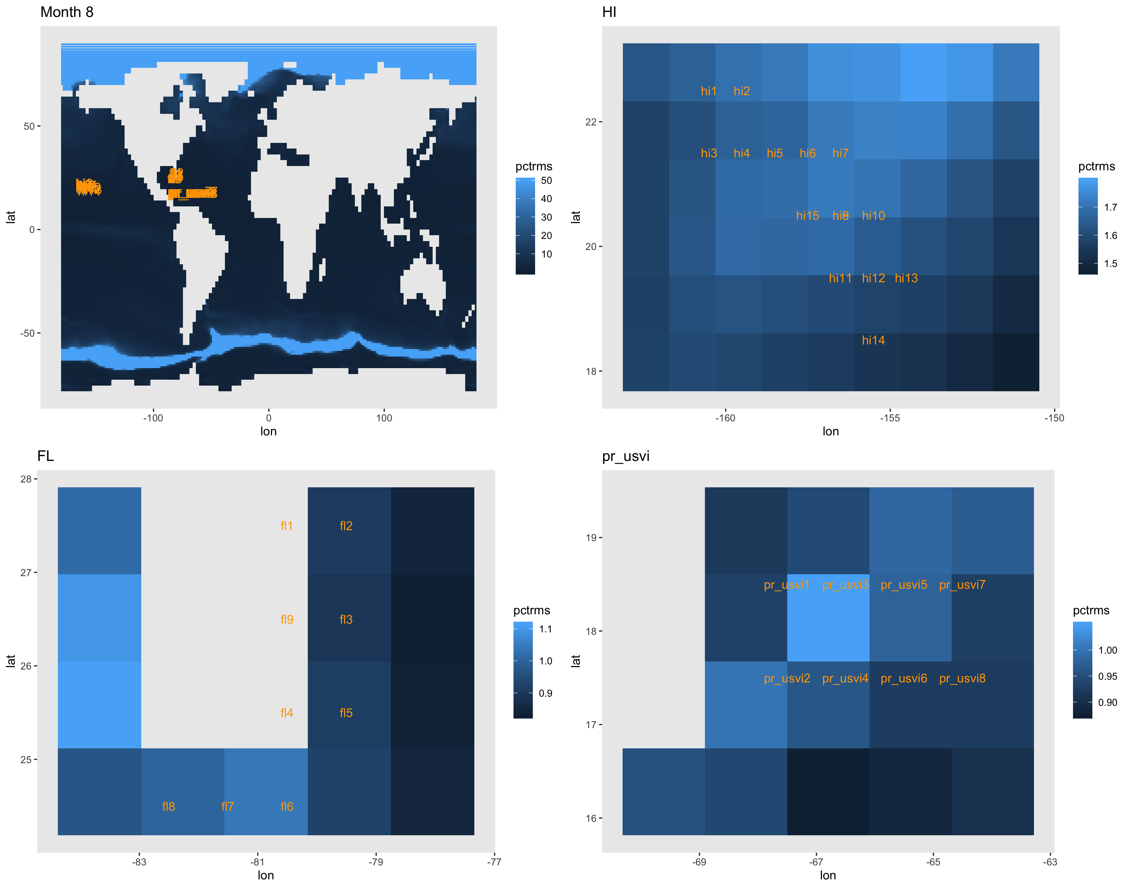
RMS as percent of local ESM temperature.
Color bar capped at 50% error on the global map.
RMS in degrees celsius

Slide 10
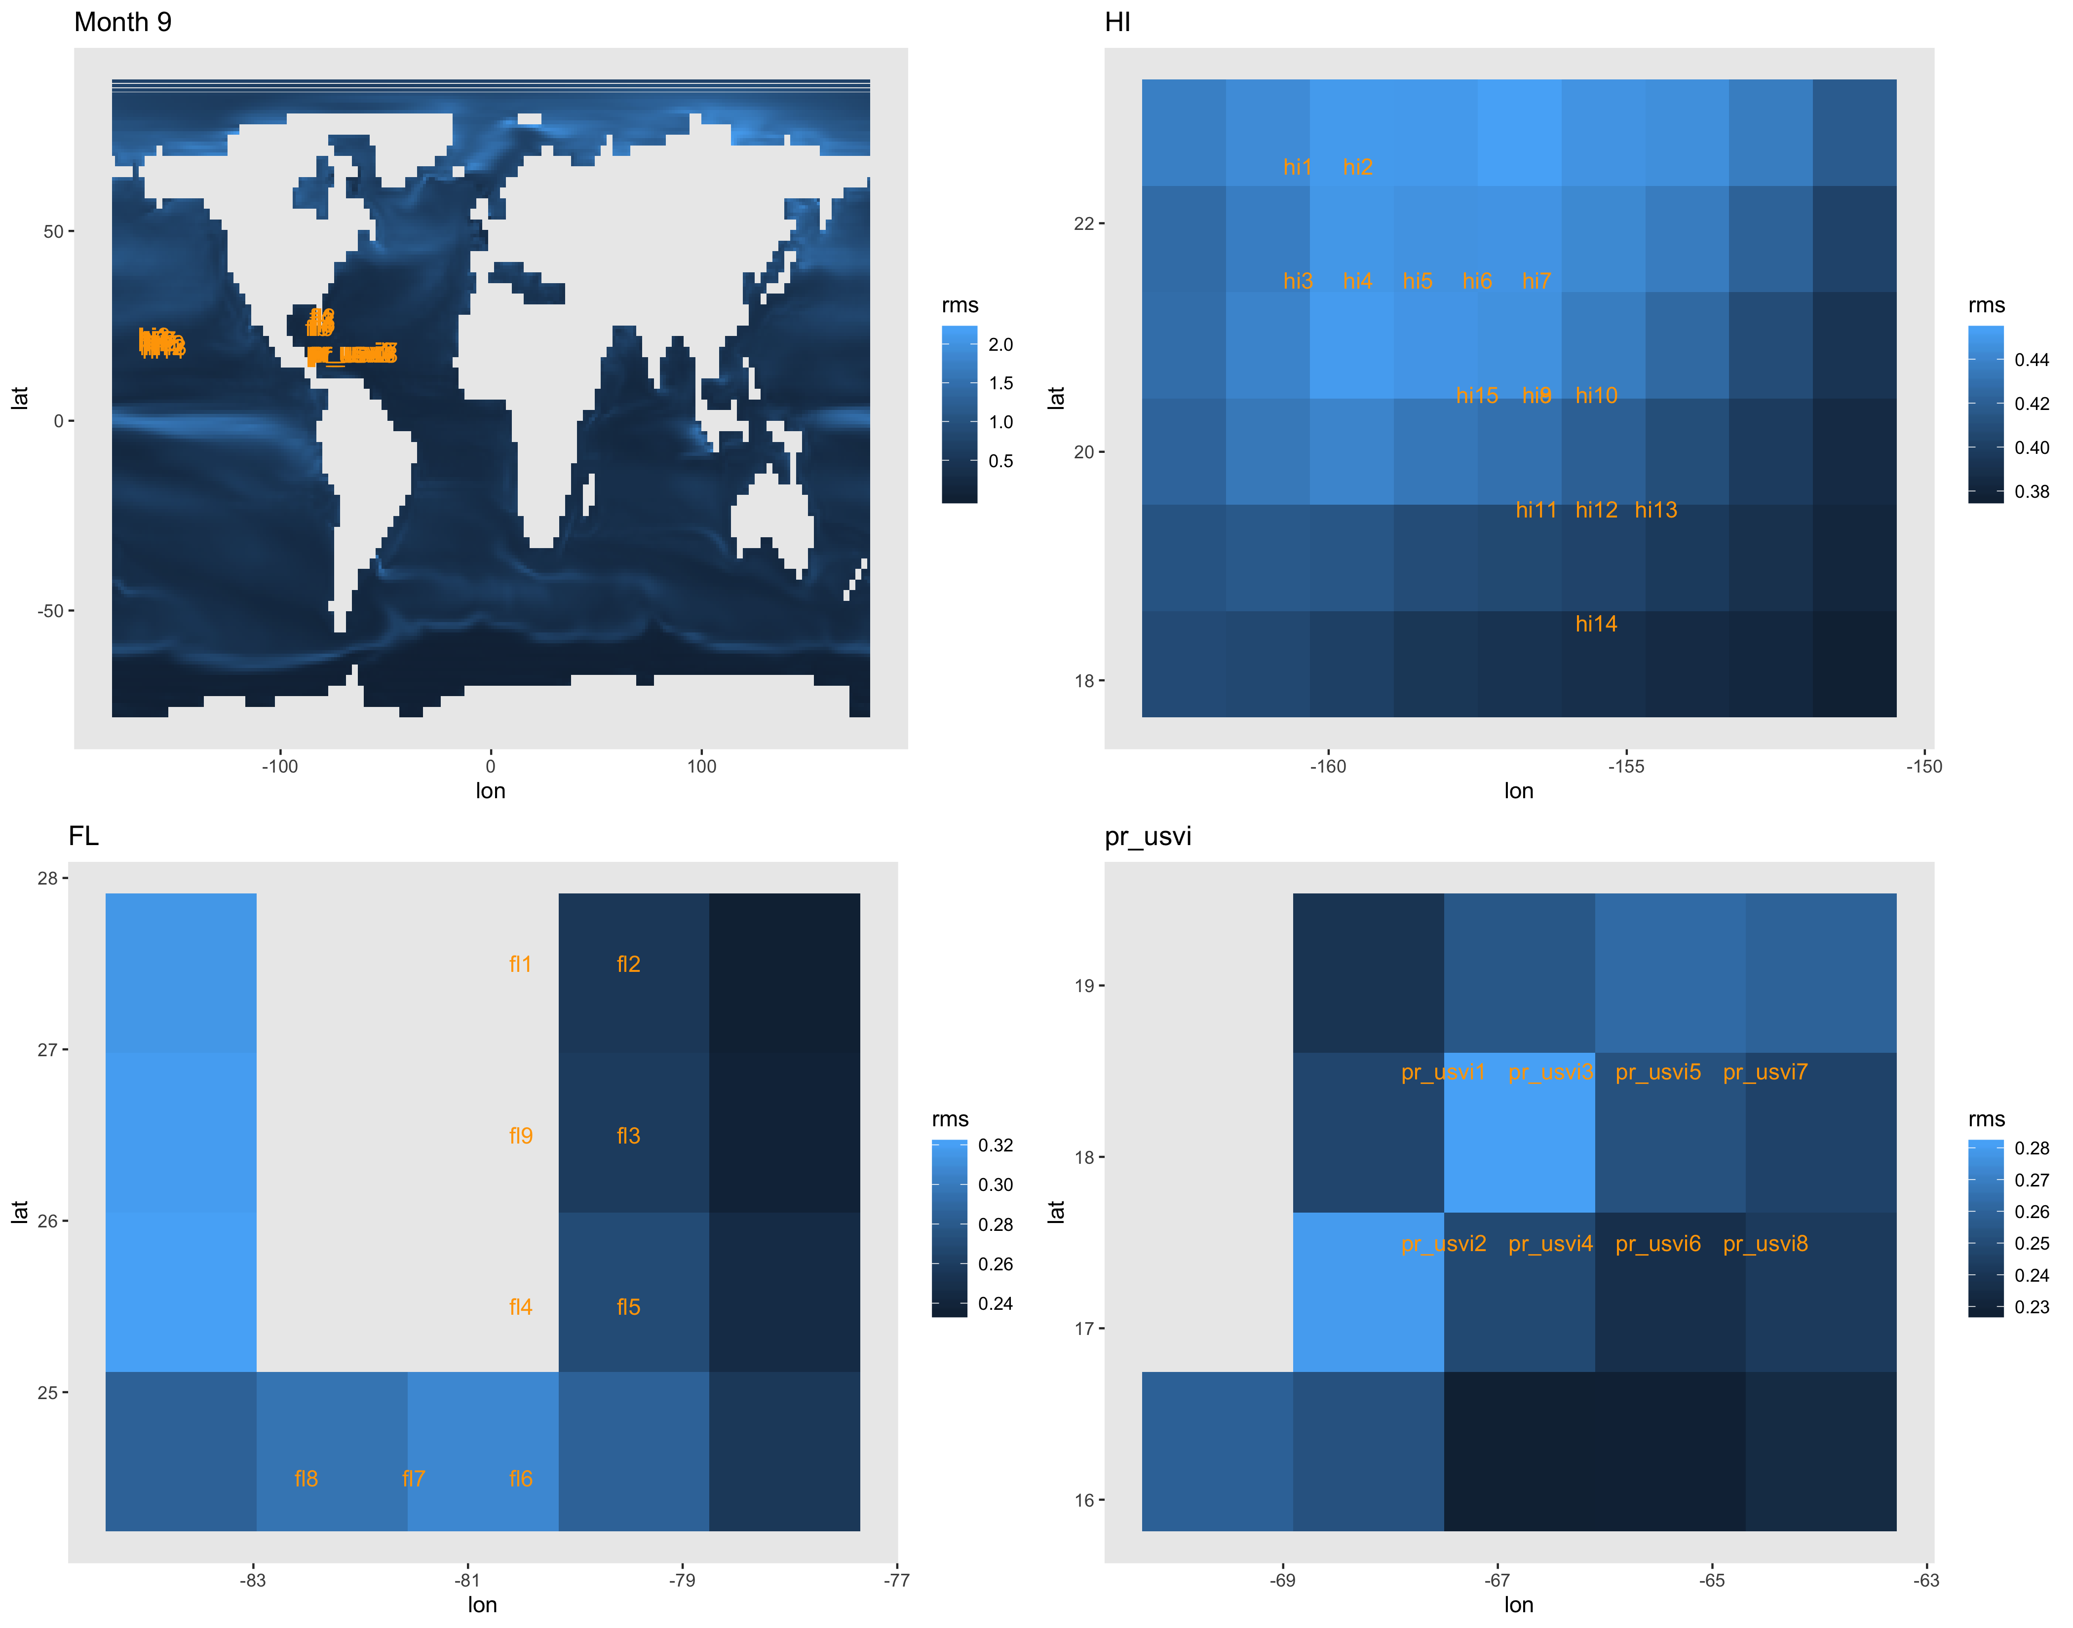
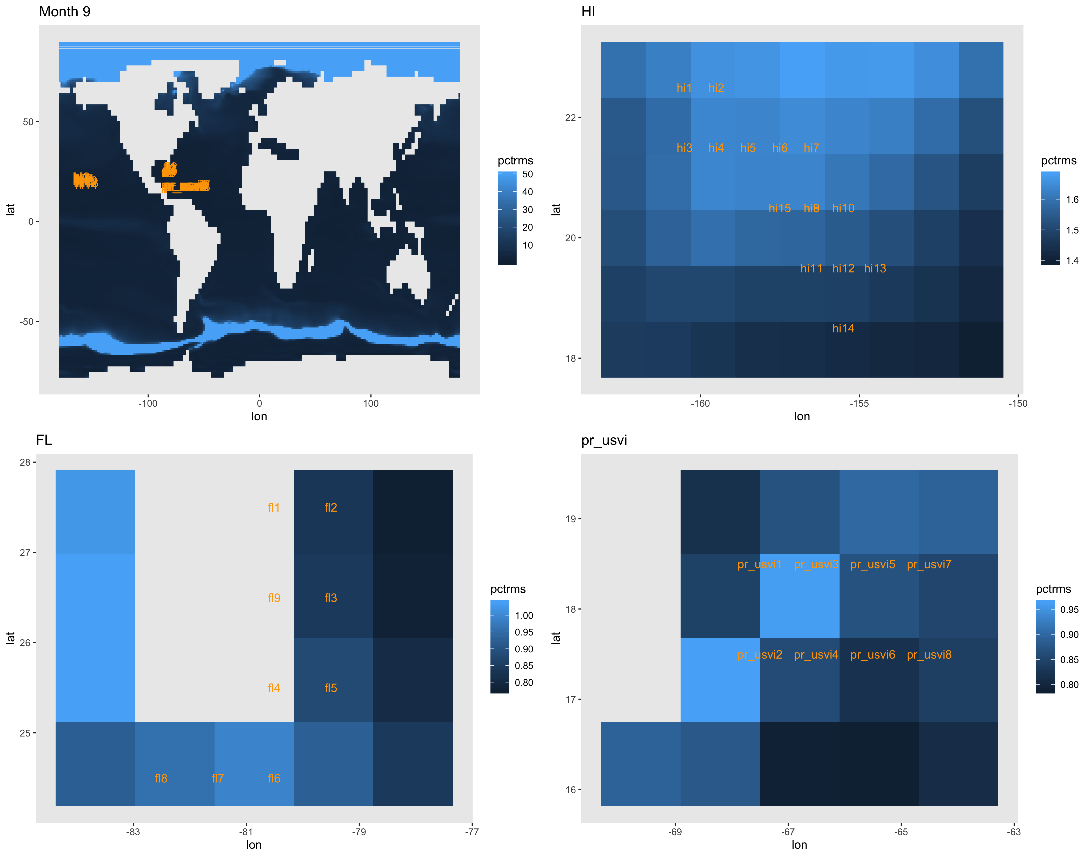
RMS as percent of local ESM temperature.
Color bar capped at 50% error on the global map.
RMS in degrees celsius

Slide 11
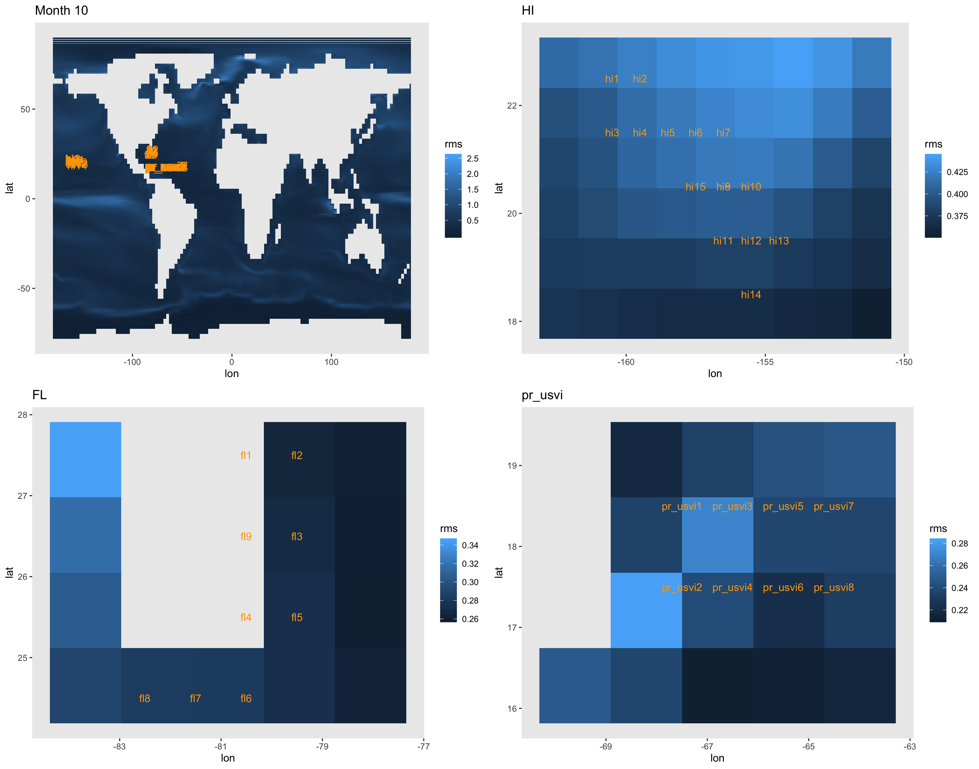
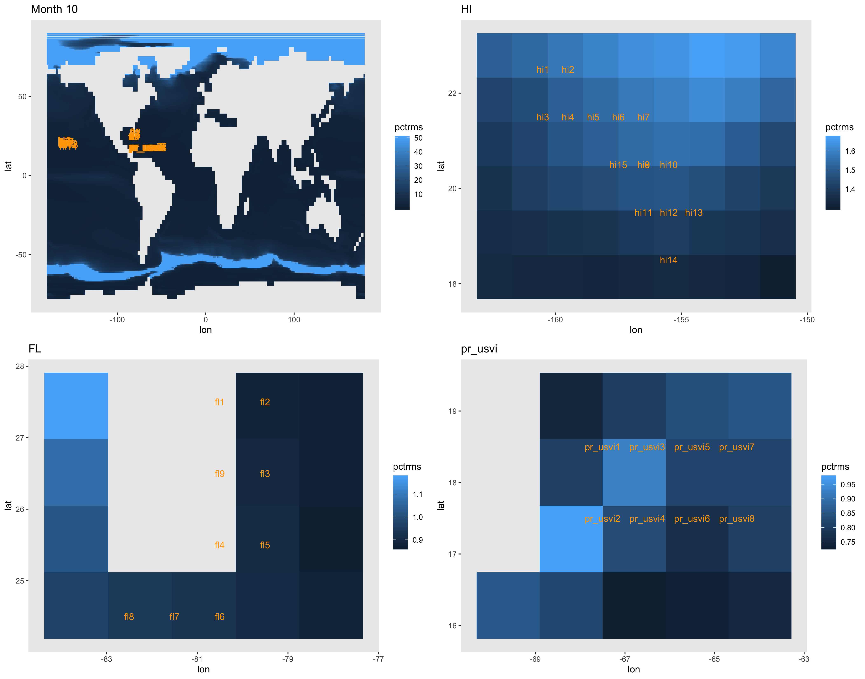
RMS as percent of local ESM temperature.
Color bar capped at 50% error on the global map.
RMS in degrees celsius

Slide 12
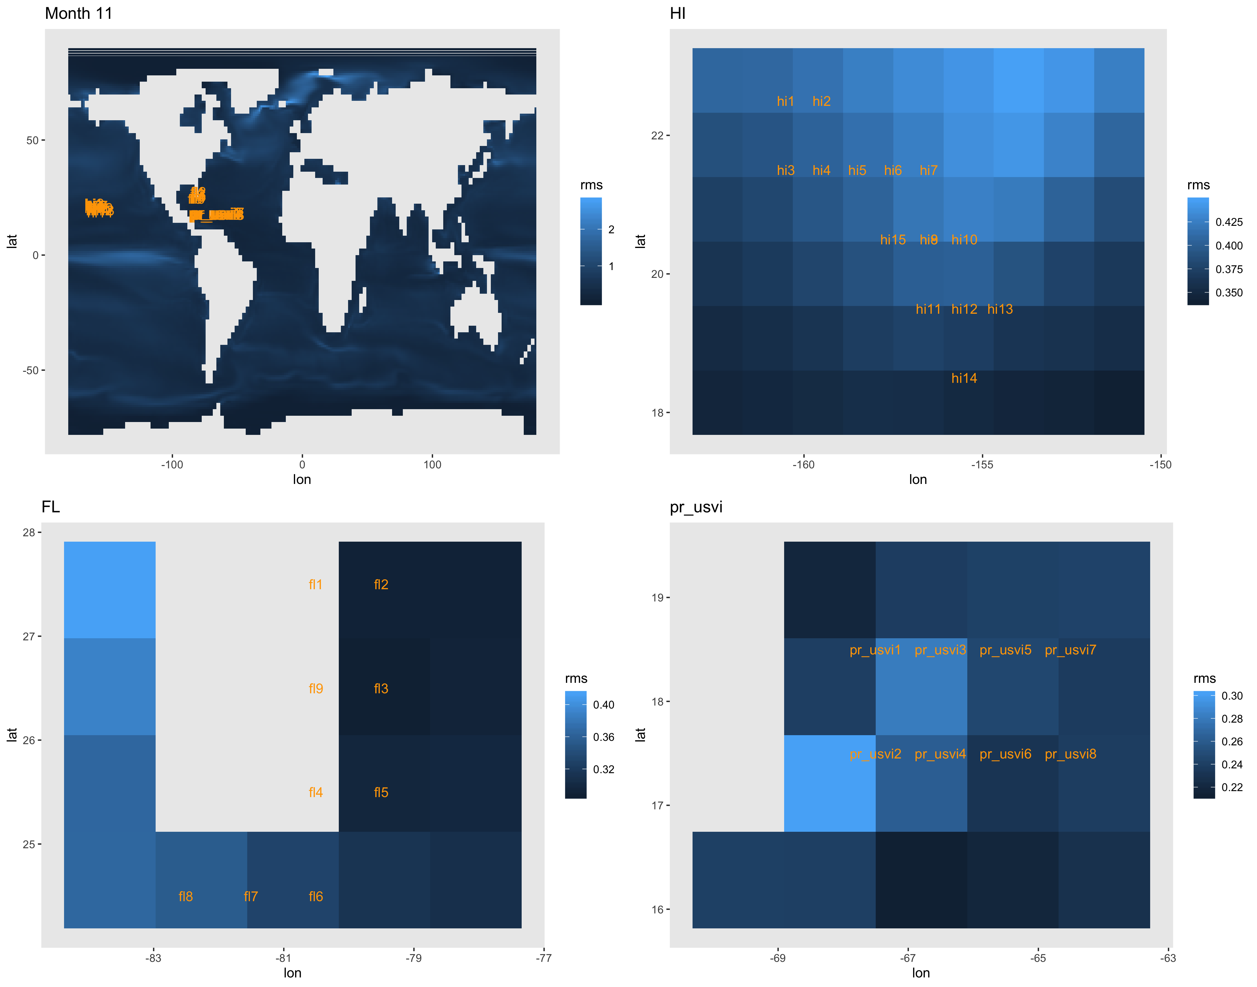
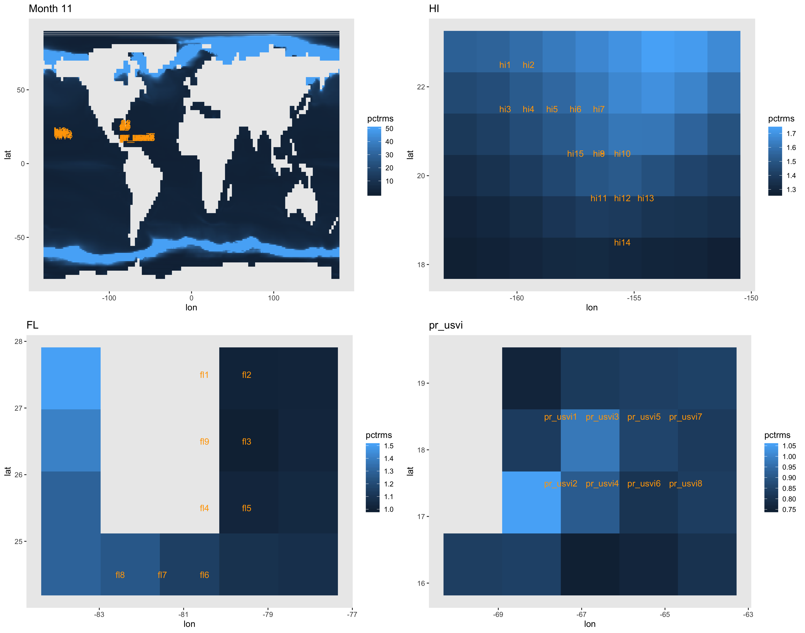
RMS as percent of local ESM temperature.
Color bar capped at 50% error on the global map.
RMS in degrees celsius

Slide 13
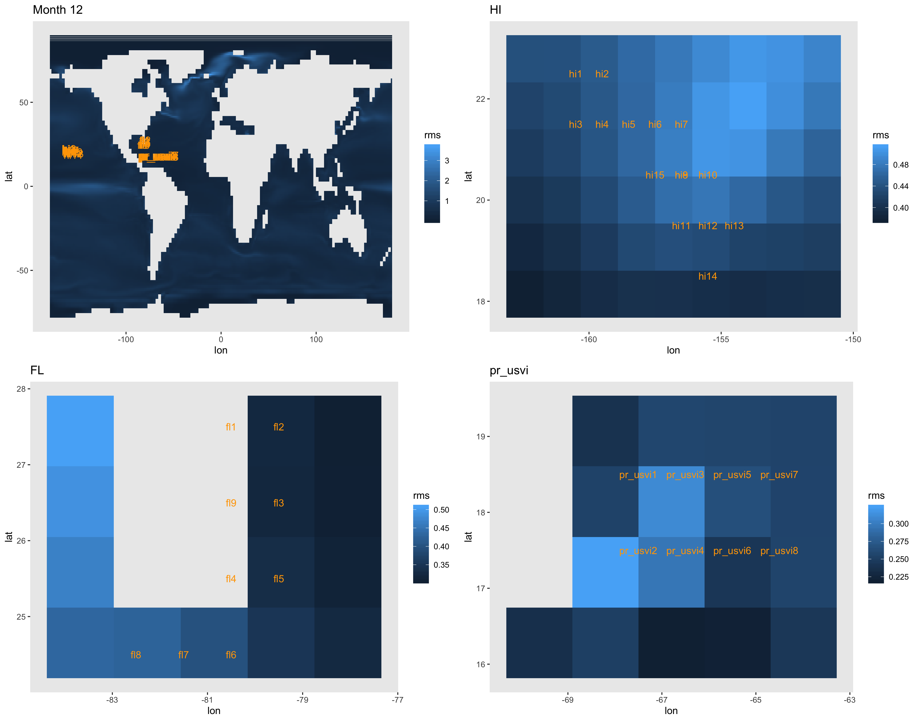
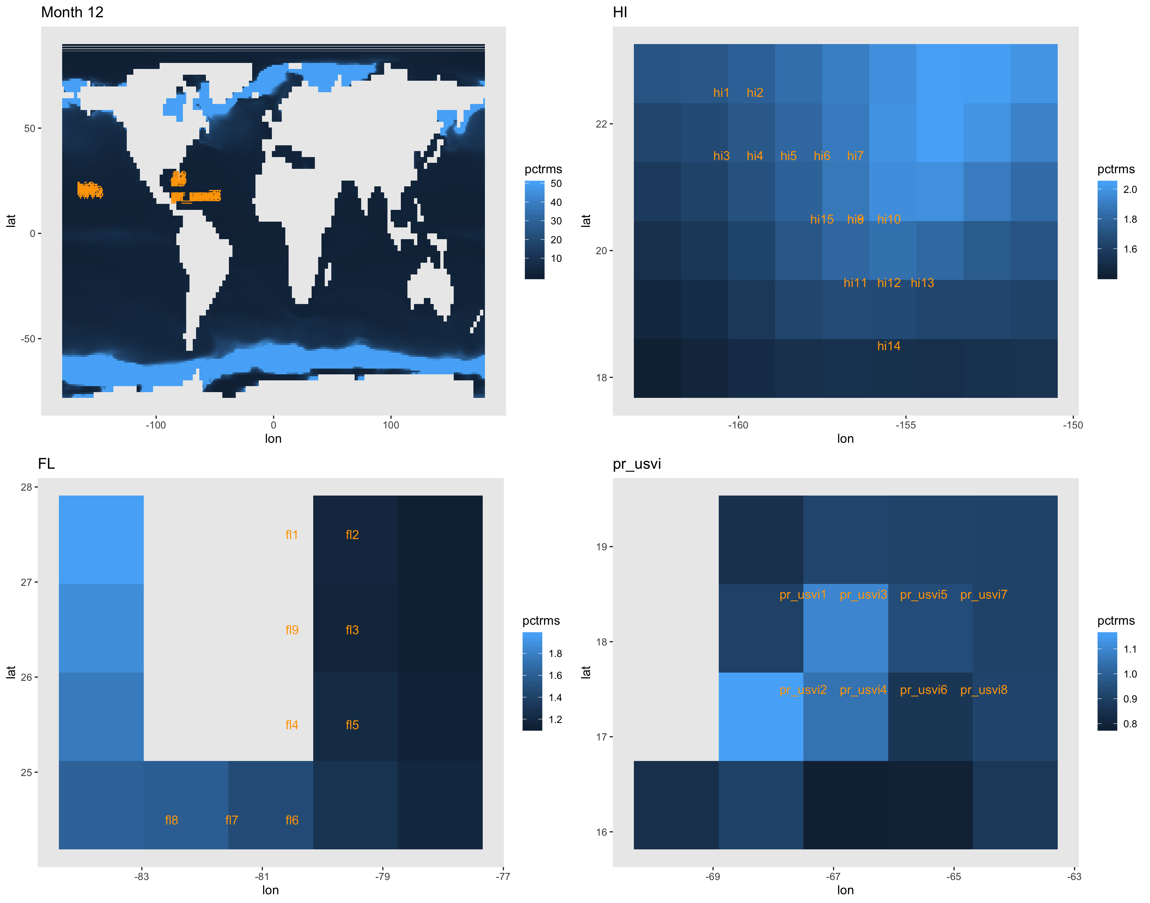
RMS as percent of local ESM temperature.
Color bar capped at 50% error on the global map.
RMS in degrees celsius

Slide 14
Global maps to check overall possibility of pattern scaling SST. Other 3 panels in each figure are the errors at the sites of interest for the EPA coral health work. Every panel is on its own color bar scale because they are prelim figures, sorry!
RMS as percent of local ESM temperature.
Color bar capped at 50% error on the global map.
RMS in degrees celsius

Slide 15
RMS as percent of local ESM temperature.
Color bar capped at 50% error on the global map.
RMS in degrees celsius

Slide 16
RMS as percent of local ESM temperature.
Color bar capped at 50% error on the global map.
RMS in degrees celsius

Slide 17
RMS as percent of local ESM temperature.
Color bar capped at 50% error on the global map.
RMS in degrees celsius

Slide 18
RMS as percent of local ESM temperature.
Color bar capped at 50% error on the global map.
RMS in degrees celsius

Slide 19
RMS as percent of local ESM temperature.
Color bar capped at 50% error on the global map.
RMS in degrees celsius

Slide 20
RMS as percent of local ESM temperature.
Color bar capped at 50% error on the global map.
RMS in degrees celsius

Slide 21
RMS as percent of local ESM temperature.
Color bar capped at 50% error on the global map.
RMS in degrees celsius

Slide 22
RMS as percent of local ESM temperature.
Color bar capped at 50% error on the global map.
RMS in degrees celsius

Slide 23
RMS as percent of local ESM temperature.
Color bar capped at 50% error on the global map.
RMS in degrees celsius

Slide 24
RMS as percent of local ESM temperature.
Color bar capped at 50% error on the global map.
RMS in degrees celsius

Slide 25
RMS as percent of local ESM temperature.
Color bar capped at 50% error on the global map.
RMS in degrees celsius

Slide 26
Global maps to check overall possibility of pattern scaling SST. Other 3 panels in each figure are the errors at the sites of interest for the EPA coral health work. Every panel is on its own color bar scale because they are prelim figures, sorry!
RMS as percent of local ESM temperature.
Color bar capped at 50% error on the global map.
RMS in degrees celsius

Slide 27
RMS as percent of local ESM temperature.
Color bar capped at 50% error on the global map.
RMS in degrees celsius

Slide 28
RMS as percent of local ESM temperature.
Color bar capped at 50% error on the global map.
RMS in degrees celsius

Slide 29
RMS as percent of local ESM temperature.
Color bar capped at 50% error on the global map.
RMS in degrees celsius

Slide 30
RMS as percent of local ESM temperature.
Color bar capped at 50% error on the global map.
RMS in degrees celsius

Slide 31
RMS as percent of local ESM temperature.
Color bar capped at 50% error on the global map.
RMS in degrees celsius

Slide 32
RMS as percent of local ESM temperature.
Color bar capped at 50% error on the global map.
RMS in degrees celsius

Slide 33
RMS as percent of local ESM temperature.
Color bar capped at 50% error on the global map.
RMS in degrees celsius

Slide 34
RMS as percent of local ESM temperature.
Color bar capped at 50% error on the global map.
RMS in degrees celsius

Slide 35
RMS as percent of local ESM temperature.
Color bar capped at 50% error on the global map.
RMS in degrees celsius

Slide 36
RMS as percent of local ESM temperature.
Color bar capped at 50% error on the global map.
RMS in degrees celsius

Slide 37
RMS as percent of local ESM temperature.
Color bar capped at 50% error on the global map.
RMS in degrees celsius

